Slide 1

Step Presentation
2023W-T2 AISC2006
Group B

Slide 2
Problem Statement
The data is of Airline Industry in which there are 30 features of various flights. We are trying to find what are the main attributes in the whole cause flights to be cancelled.
This problem can help the airline companies to estimate cost to the company for cancellation of the flight which can help them the budget accordingly.

Slide 3
Project Management

Slide 4
Todos
Selection of data source
Initial data Analysis
Data Cleaning
Model Creation
Generating Insights

Slide 5
Team Structure
Janit Jindal
Megha Malhotra
Kamini
Parul Mehndiratta
Vidhut Sharma
Meera Gangani
Abu Bakar

Slide 6
Matrix of Duties - Cleaning
Data cleaning Duties:
Corruption data: Janit Jindal – removal of corrupted or non-identified data.
Missing Values: Abu Bakar and Parul Mehndiratta – replacement of missing values in the data.
Noisy Data: Meera and Kamini – removal of outliers in the data.
Format Error: Megha Malhotra and Vidhut Sharma - fixing the wrong values and format errors in the data.

Slide 7
Pert Chart- Cleaning
Task Name | Week 1 | Week 2 | Week 3
Choosing Dataset
Requirement Gathering
Cleaning Dataset
Data Analysis
Compiling work
Presentation Completion

Slide 8
Tracking Progress
Decide the dataset for the project
Daily sync up with teams to check on the progress
Collaborating with each other to keep the work upto date

Slide 9
Milestones
Found the preferrable data and source of data.
Analysed the issues in the data.
Divided the work among the teammates.
Performed cleaning of data.
Selected columns as per cleaning.
Visualized the data and created insights
Summarized the results found.

Slide 10
Dataset Analysis

Slide 11

Data Description
As airplanes have become the fastest means of transport to travel to long distances, there are certain factors which are always considered by the Airline industry. Thus, we have selected this data to gain the knowledge and information about the issues faced by the industry and how the obstacles can be removed.
The data is taken from Kaggle as it allows publishers to collab and feasible to find various data sets.
The data is a time series data of 6 months.

Slide 12
Data Attributes
DepTime: Time the flight was departured from the airport.
ArrTime: Time the flight reached to the airport.
CRSDepTime: Schelduled/Computerised departure time.
CRSArrTime: Schelduled/Computerised Arrival time.
UniqueCarrier: IATA code (location and plane identifier code).
FlightNum: Flight number.
TailNum: Code to identify specific airplane.
ActualElapsedTime: The time from gate departure time to gate arrival time.
CRSElapsedTime: Schelduled/Computerised Elapsed Time
AirTime: moment of commencing to moment of touching the surface.
ArrDelay: Delay in arrival of airplane
DepDelay: Delay in Departure of airplane
Org: Location of departure of the flight.
Dest: Location of Arrival of the flight.

Slide 13
Data Attributes
Distance: Distance between location of origin and destination.
TaxiIn: The average difference between Actual Wheels Off time and Actual Gate Out time, in minutes
TaxiOut: the time spent by a flight between its actual off-block time (AOBT) and actual take-off time (ATOT).
Cancelled: whether flight were cancelled or not
Cancellation Code: code of cancellation of flight
Diverted: whether flight were diverted or not
CarrierDelay: aircraft cleaning, aircraft damage, awaiting the arrival of connecting passengers or crew, baggage, bird strike, cargo loading, catering, etc.
WeatherDelay: caused by extreme or hazardous weather conditions.
NASDelay: non-extreme weather conditions, airport operations, heavy traffic volume, air traffic control, etc.
SecurityDelay: caused by evacuation of a terminal or concourse, re-boarding of aircraft because of security breach, etc.
LateAircraftDelay: arrival delay at an airport due to the late arrival of the same aircraft at a previous airport. The ripple effect of an earlier delay at downstream airports is referred to as delay propogation.

Slide 14
Figuring out Outputs

Slide 15
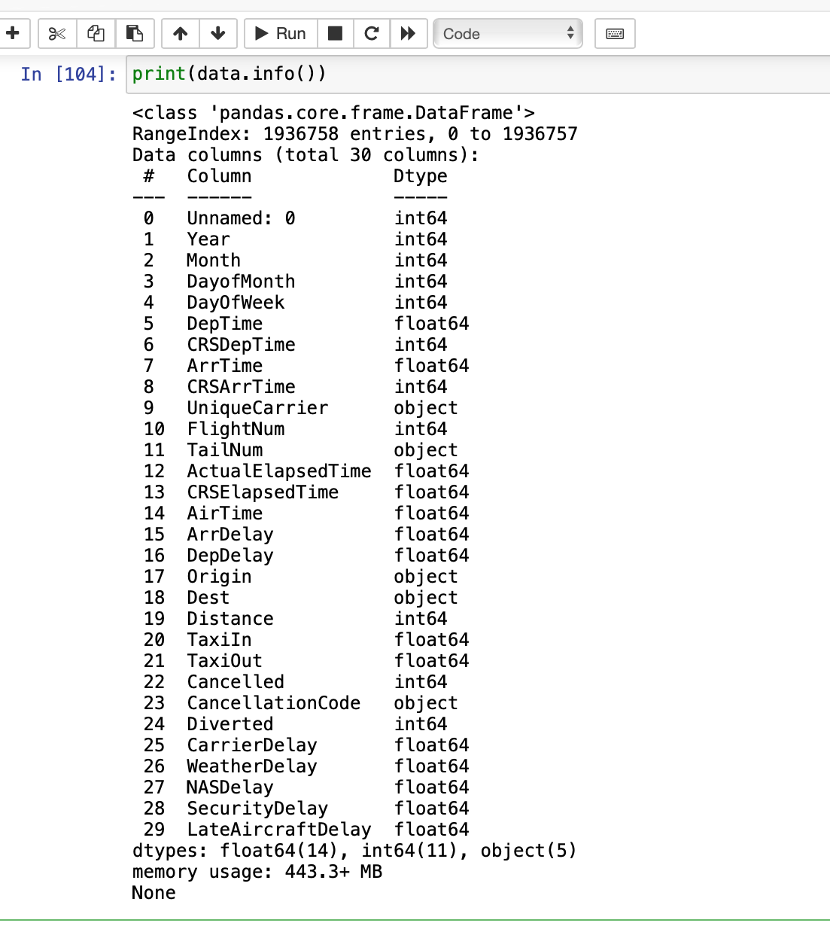
Descriptive Analysis
Checking the data types of data provided

Slide 16
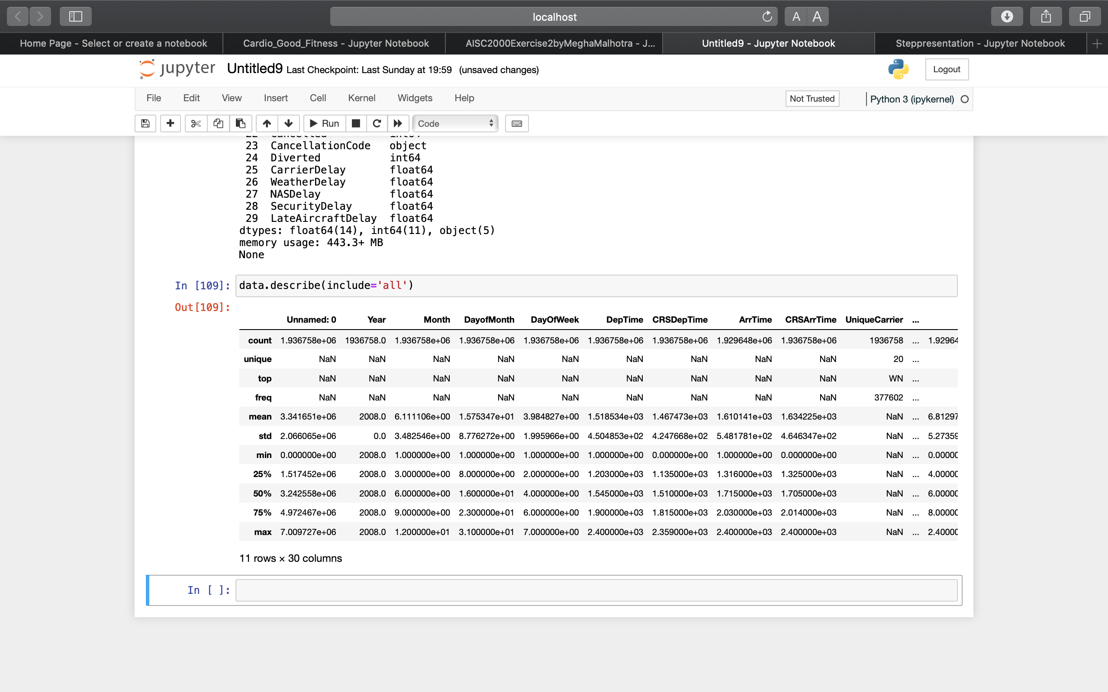
Descriptive Analysis

Slide 17
Data Cleaning

Slide 18
Cleaning Steps
Start with minimal dataset.
Detect
Standardize
Correct

Slide 19
Quality Control
Work on copy of data
Decide cleaning and transformation steps.
Use libraries

Slide 20
Python Libraries Used for Data Cleaning
Pandas
Numpy
matplotlib

Slide 21
Cleaning and Transformation Methods
Fillna()
Ffill()
Bfill()
Replace()
Data.mode()
Data.median()
Data.std()
Np.where()
Np.abs()
Np.nan()
Ifnull.sum()
Dropna()
Data.loc()

Slide 22
Data Issues
Missing Values
Noisy
Format Errors
Corrupt Data

Slide 23
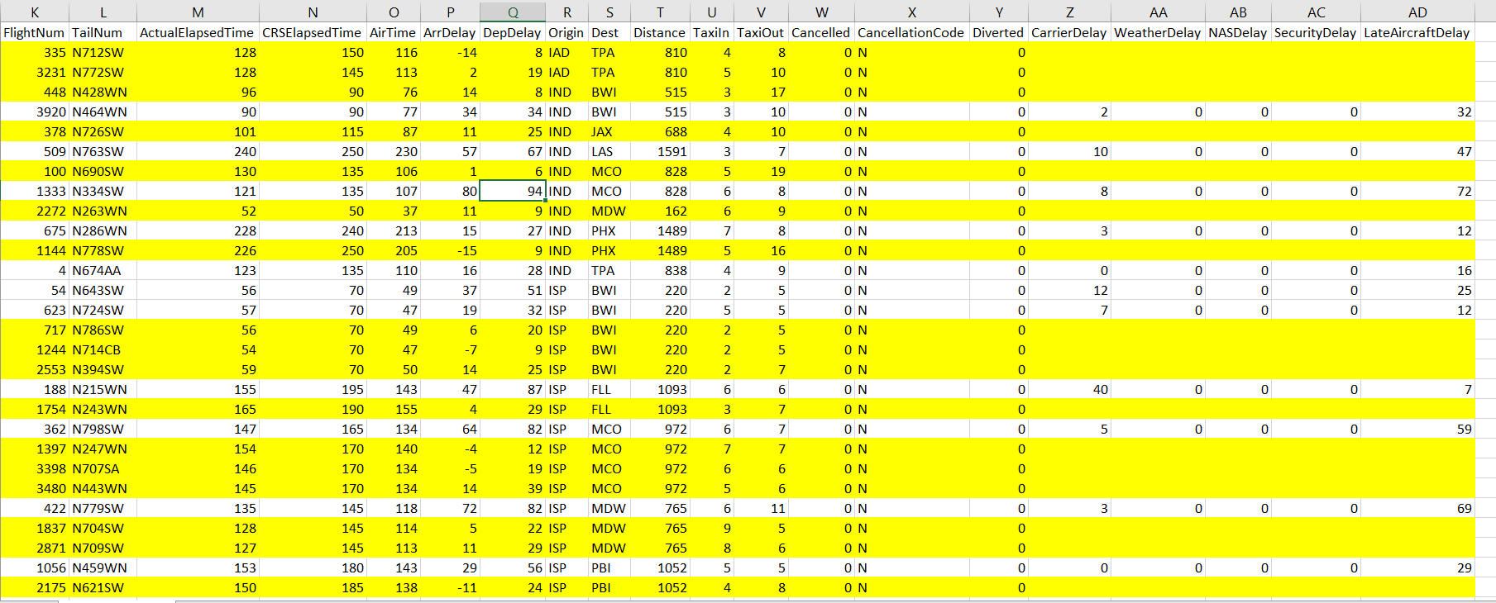
Corrupt Data
After reviewing the data for the first time, we noticed that there were many rows in which the value of each delay was null and non-identified . So, our first task was to remove the unidentified data by removing the rows.

Slide 24
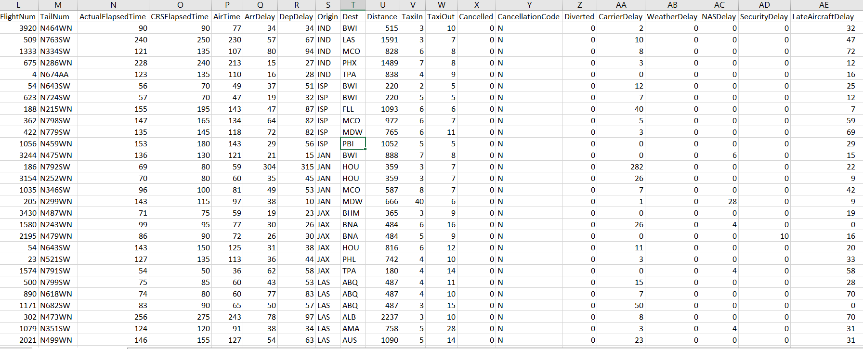
Corrupt Data -OUTPUT-
Here, after the removal of the rows we can see no unidentified data in the columns .

Slide 25
Missing Values
We have seen that a lot of the values in the columns ArrDelay (Arrival Delay) and DepDelay (Departure Delay) were "0", however while reviewing we found out that there were two certain formulas being followed in the whole data for both columns which are:
ArrDelay = carrier delay + Weather Delay + NASdelay + SecurityDelay + LateAircraftDelay
DepDelay = ArrDelay + abs(ActualElapsed - CRSElapsed)
So, by using these we replaced the values with accurate time.

Slide 26
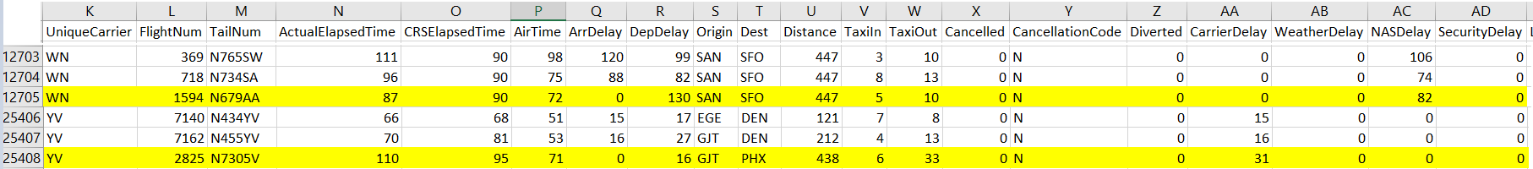
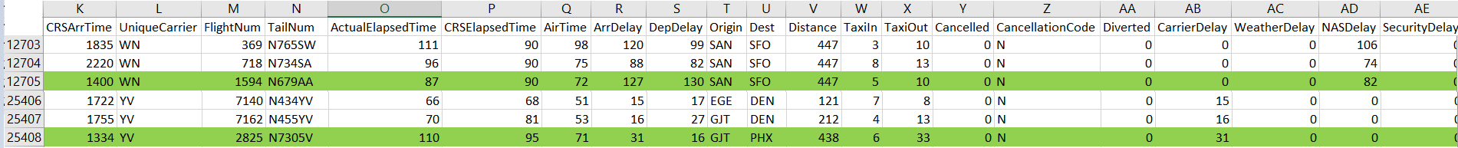
Missing Values - ArrDelay
Steps of fixation: -
Imported libraries
Read the csv file
Checked the rows having arrdelay as 0
Replaced/filled the value according the formula
Uploaded into a csv file for further cleaning

Slide 27
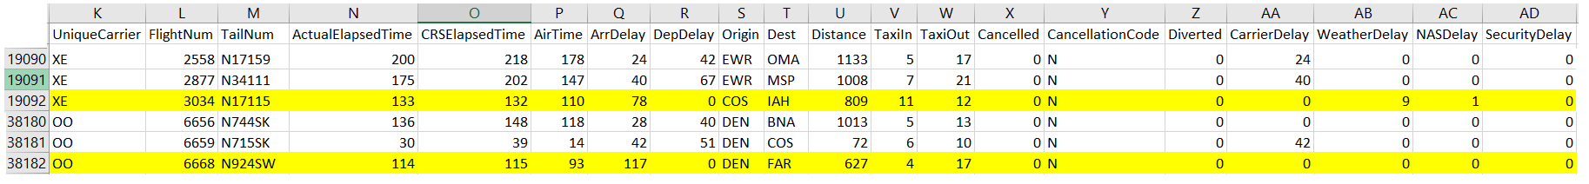
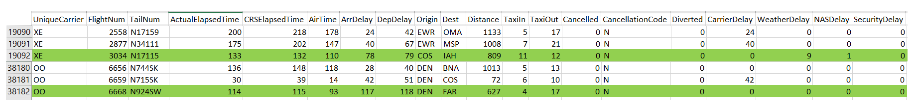
Missing Values - DepDelay
Steps of fixation: -
Imported libraries
Read the csv file
to clean the zero values decided to replace them.
replaced the zero values with null values by using the fillna() method
Used the formula and replaced the null values with it.
Uploaded into csv file for further cleaning.

Slide 28
Noisy Data
While screening the data we noticed that there are two columns which had outliers, Outliers mean having the data significantly different than the whole data, thus we decided to fix it.
The columns are TaxiIN and TaxiOut

Slide 29
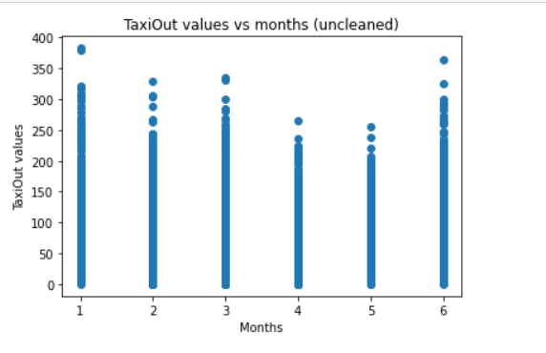
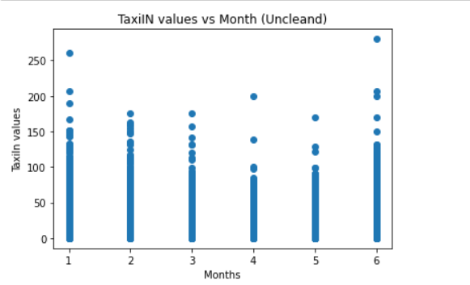
Noisy Data – TaxiIN & TaxiOut
With the help of scatter plots we can get a rough idea of outliers, as it is a time series data so chose month as 1 axis and TaxiIn column as another axis, similarly for TaxiOut.

Slide 30
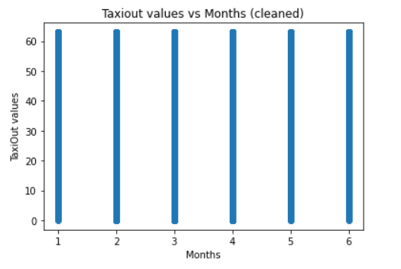
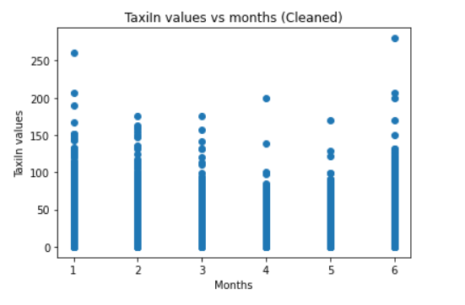
Noisy Data – TaxiIN & TaxiOut
Steps of fixation: -
First identification of outliers using z-scores method.
Decided to apply median imputation method.
After applying the above, it replaced the outliers with the median of data points.
Lastly, validated the data using matplotlib.

Slide 31
Format Errors
Along the removal of outliers and corrupted data, we recognized there were 2 columns with formatting errors, which were Dest (Destination of flight) and Distance (Distance from origin to destination). So, we decided to fix that.

Slide 32
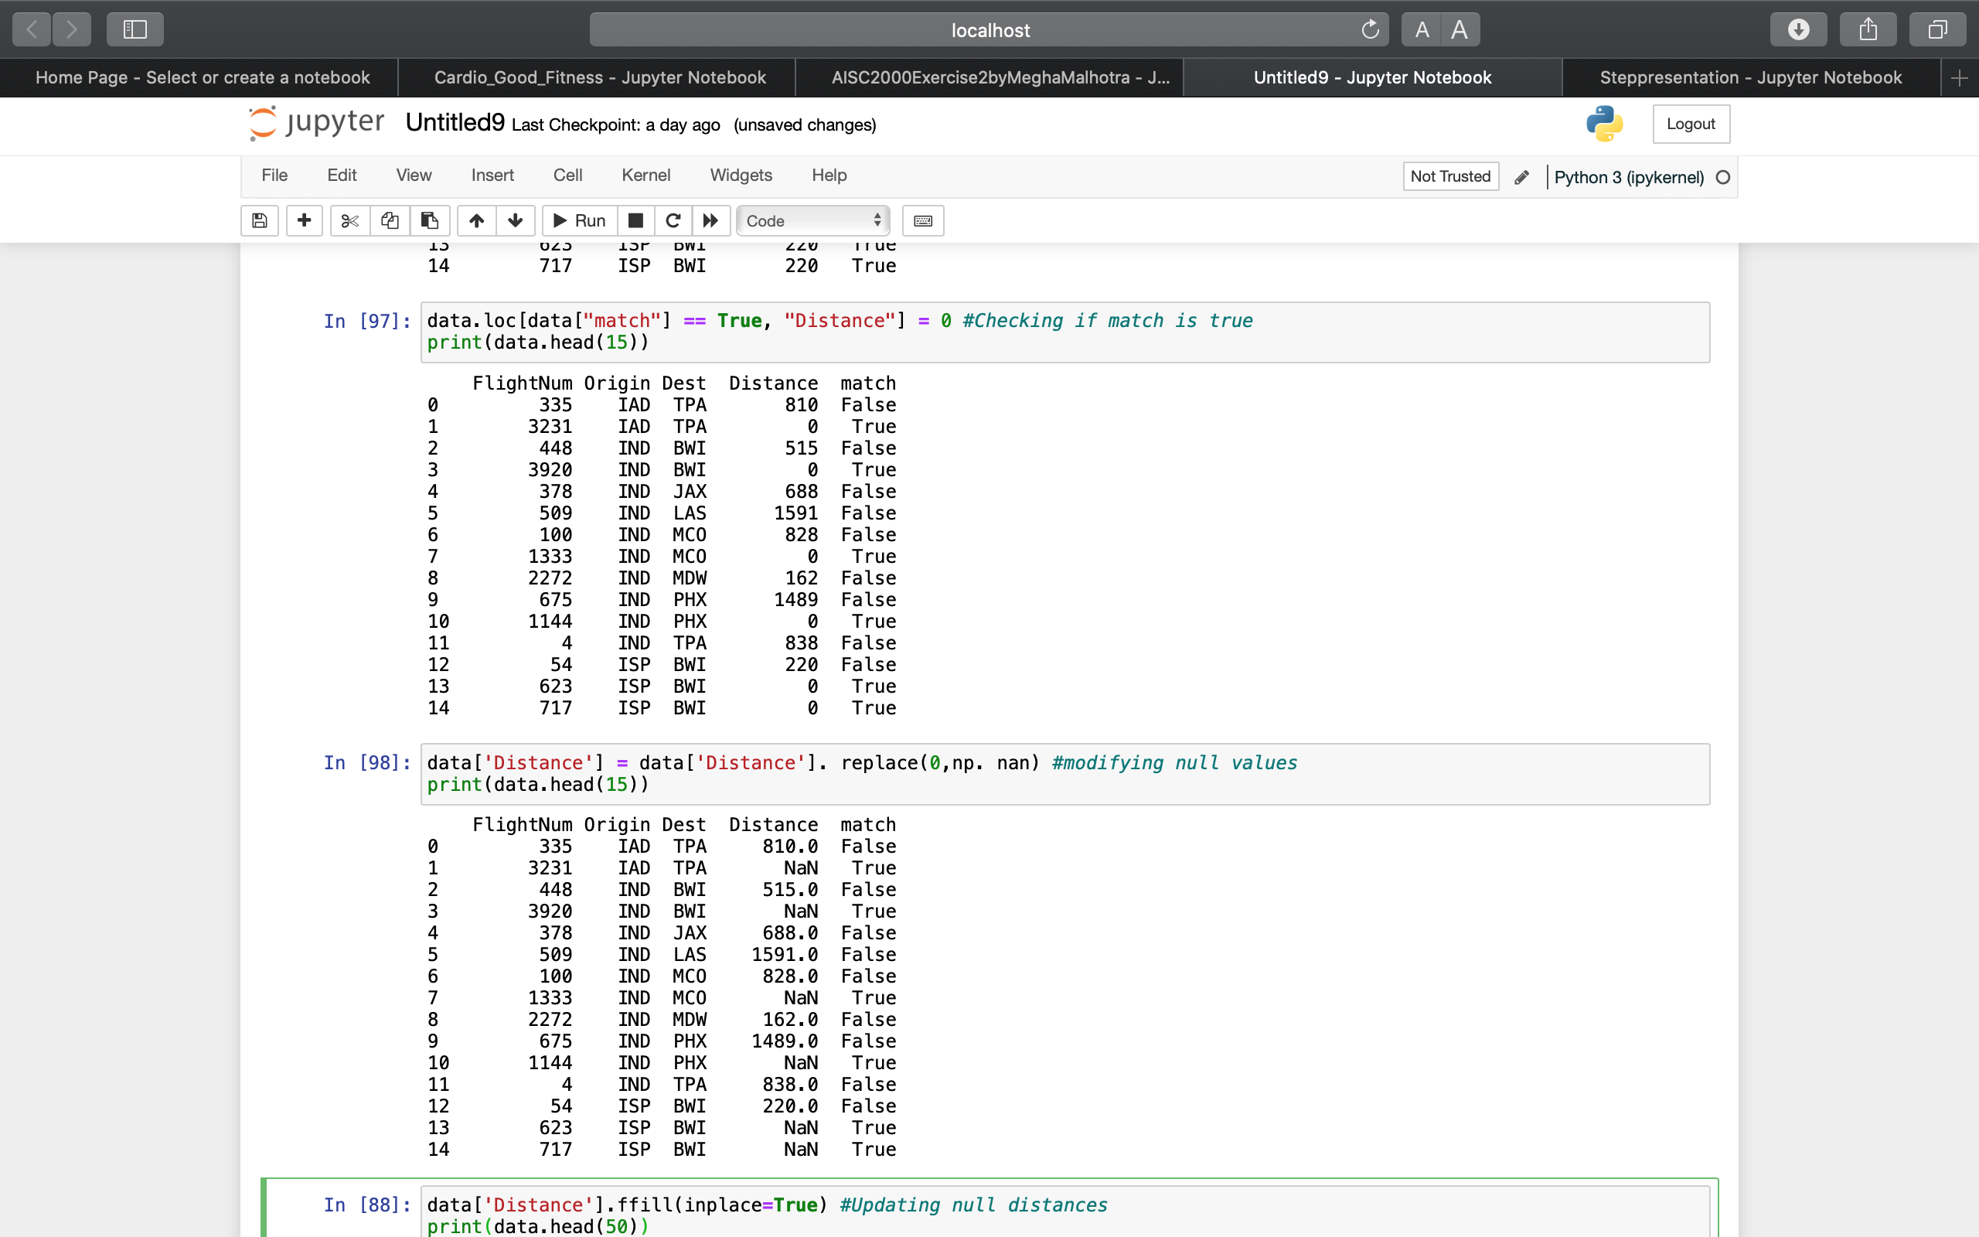
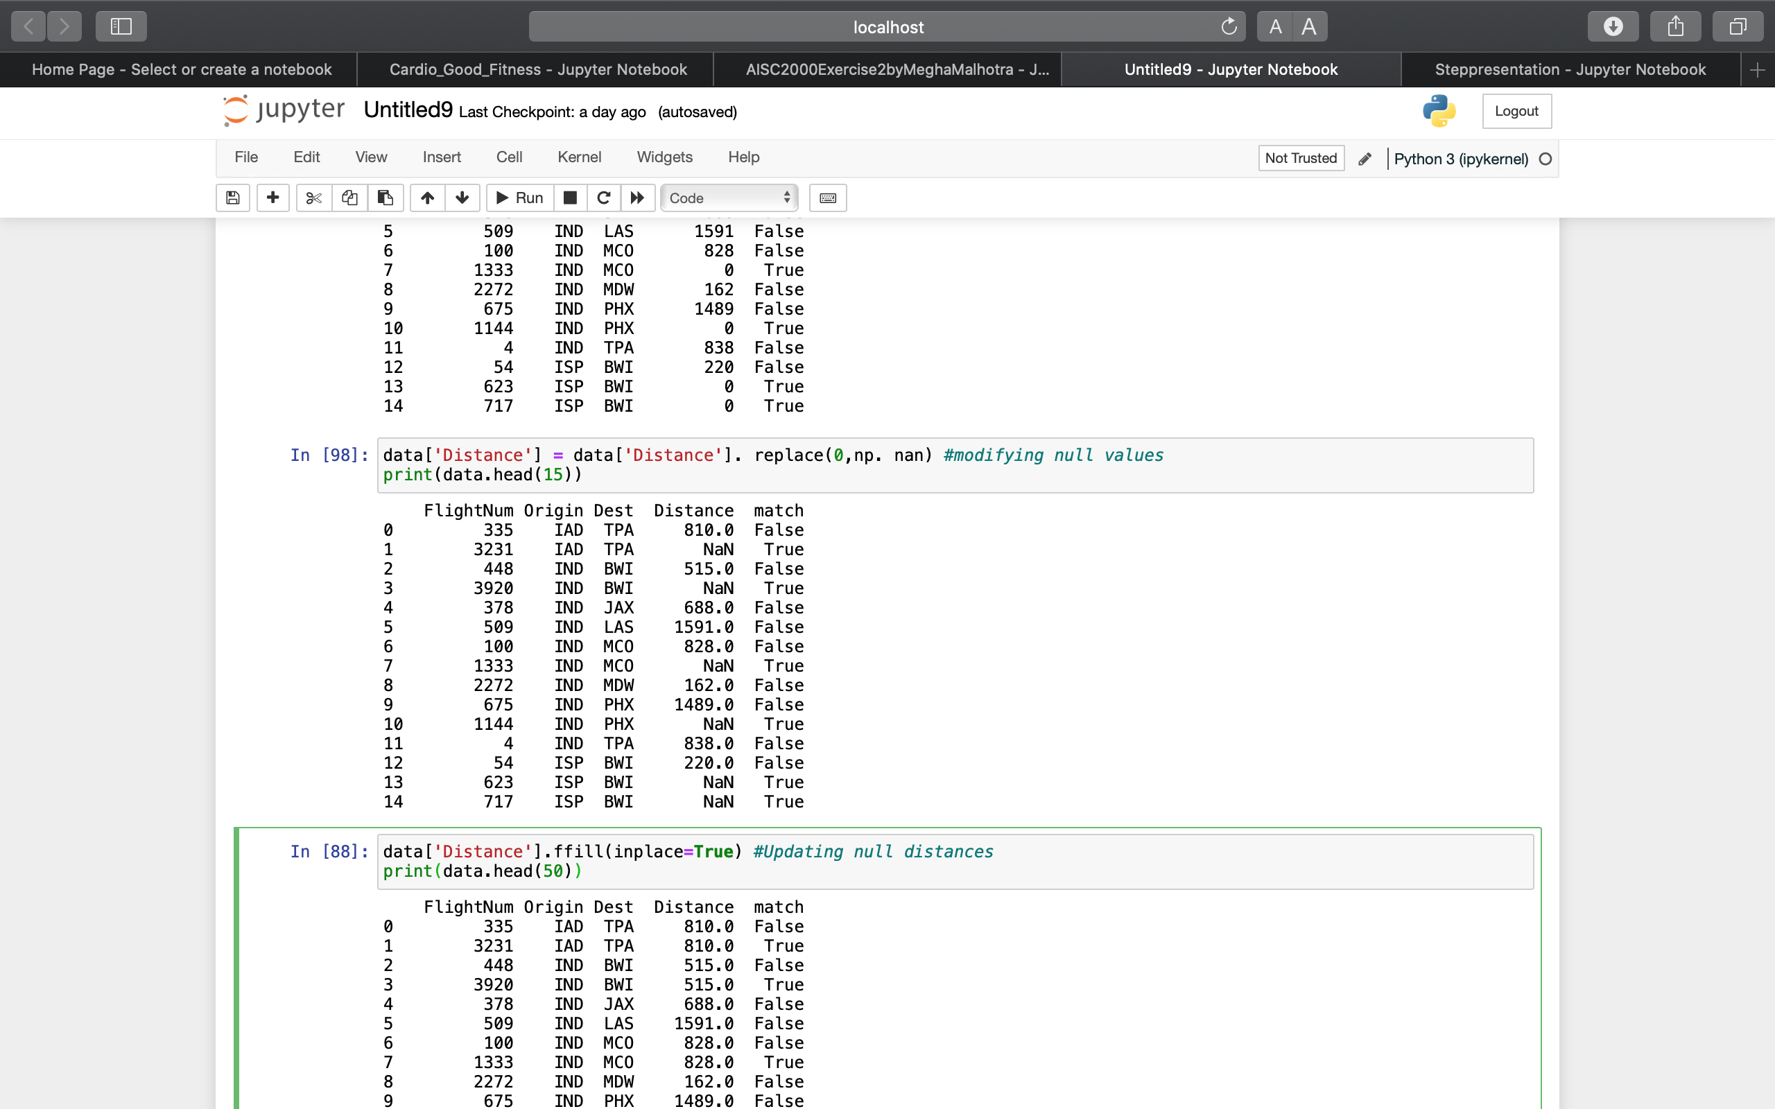
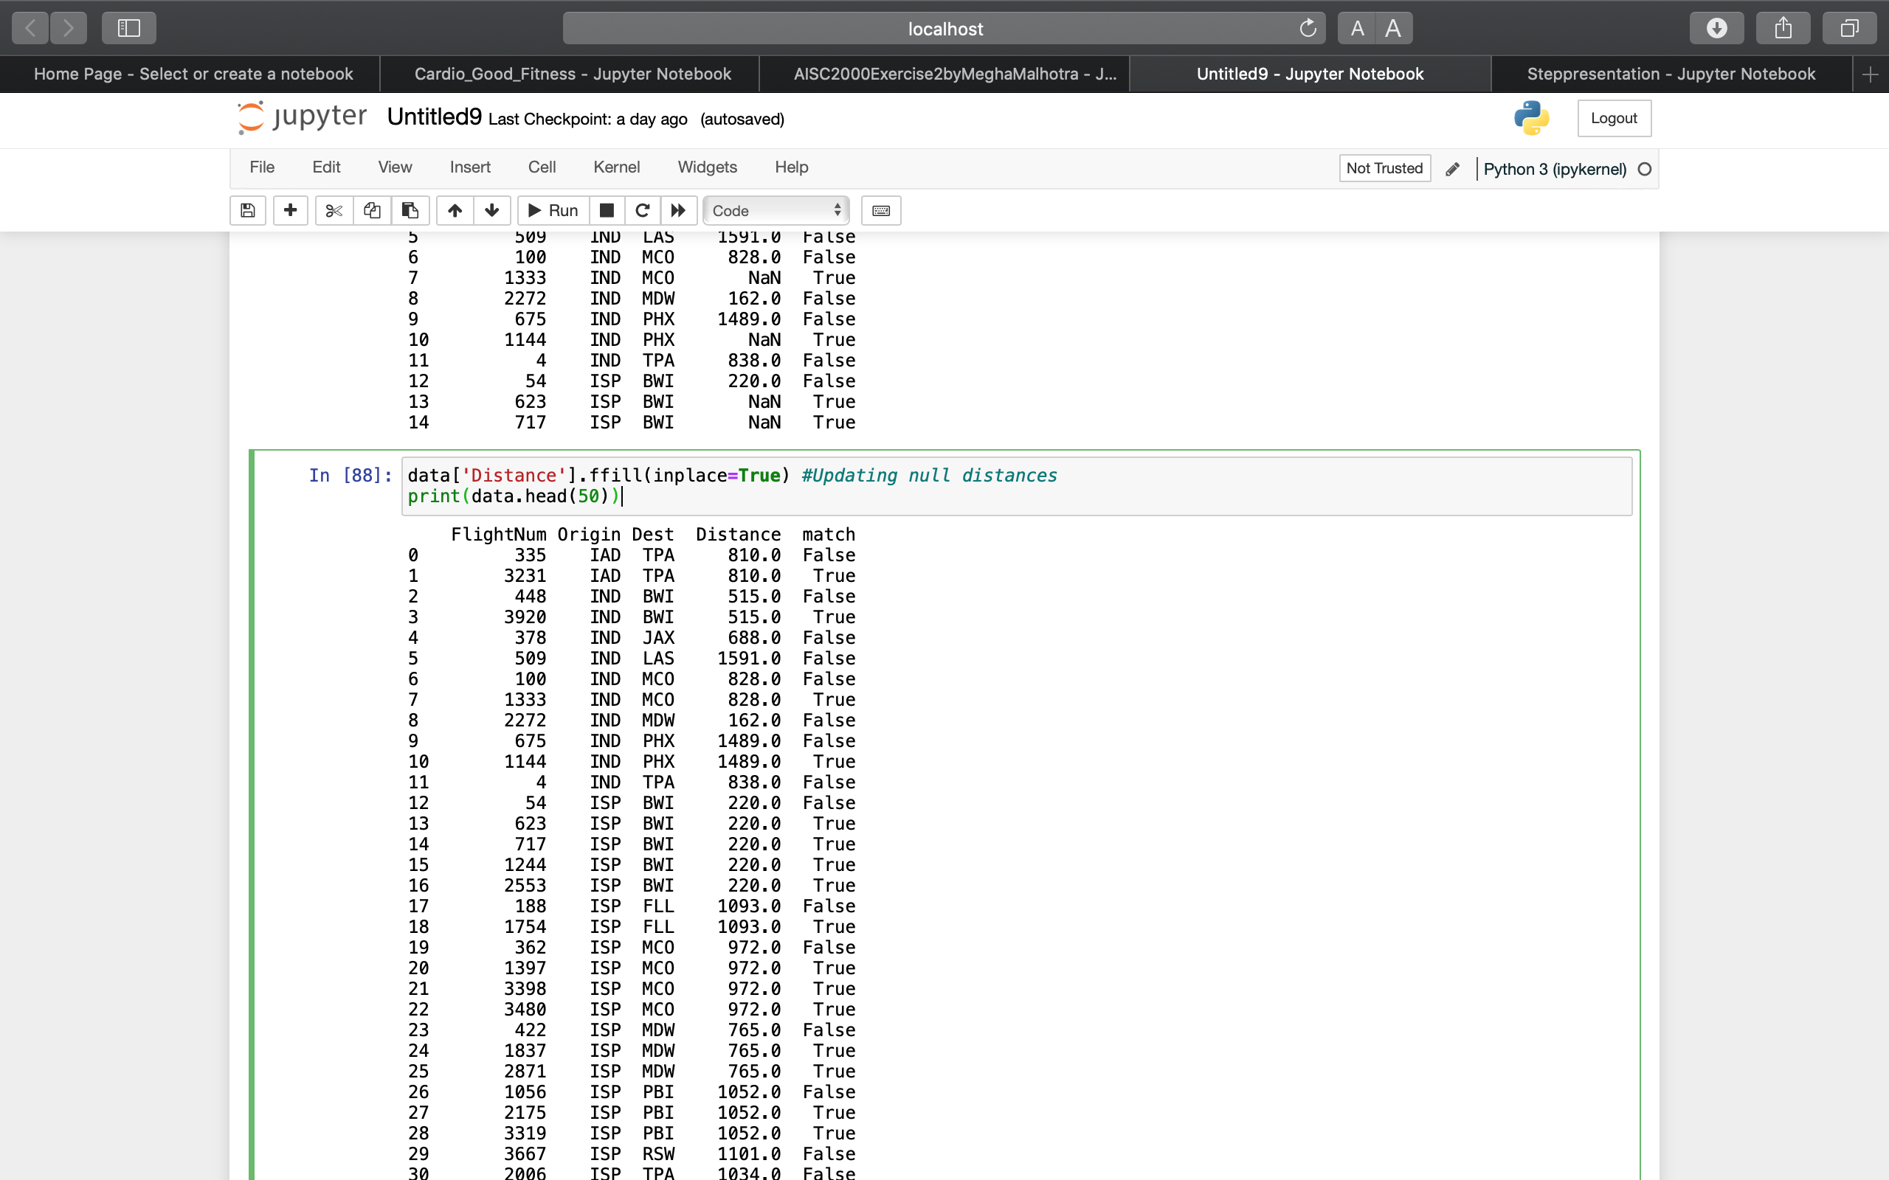
Format Errors –Distance
Steps of Fixation: -
There were some values that had 0 as the distance.
To find out the distance between origin and destination, we checked for similar origin and destination in the dataset and replaced all the null distance with the similar distances, respectively.
So, first we created another column match to find the duplicates in there and then we replaced all the values with true in match with the fill method as for this dataset we found that all rows with the same origin and destinations are together.

Slide 33
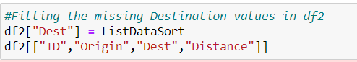
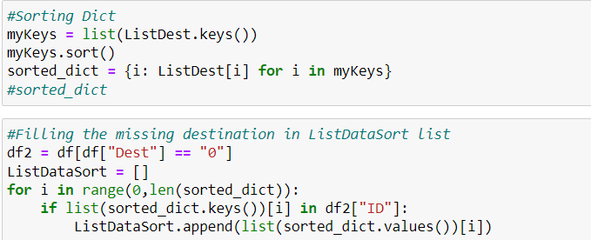
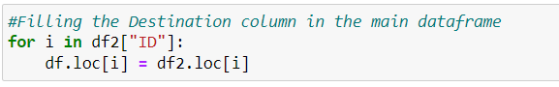
Format Errors –Destination
Steps of Fixation: -
First, read the data and understood the pattern between the Distance and Origin and then cross checked with other combinations of Origin and Distance where the values were not missing for Destination.
We can notice that by having Origin and Distance combination the Destination can be easily identified.
I was able to extract the combinations and had a solution which can identify the combination and provide me with Destination code.
After this by using dictionary sort method I was able to sort the keys which were the Id's in ascending order and was able to get the destination code without any issues.

Slide 34
Summary
To conclude, the data we have found of airline industry had various errors which we were able to remove by our skills and understanding, thus cleaning the data by looking at patterns and using graphical representations.

Slide 35
References
https://moodle.tbcollege.com/moodle/mod/resource/view.php?id=229290
https://moodle.tbcollege.com/moodle/mod/resource/view.php?id=229291
https://moodle.tbcollege.com/moodle/mod/resource/view.php?id=229292
https://www.youtube.com/watch?reload=9&v=qxpKCBV60U4&ab_channel=M%C4%B1sraTurp
https://aspm.faa.gov/aspmhelp/index/Types_of_Delay.html
https://www.kaggle.com/datasets/giovamata/airlinedelaycauses

Slide 36
Thank You!

Slide 37
Data Visualization

Slide 38
Matrix of Duties - Visualization
Visualization has been done with respect to the columns cleaned by each member: -
Abu Bakar - Visualization with respect to DepDelay
Vidhut Sharma - Visualization with respect to Destination
Megha Malhotra - Visualization with respect to Distance
Parul Mehndiratta - Visualization with respect to ArrDelay
Meeraben - Visualization with respect to TaxiIn
Kamini - Visualization with respect to TaxiOut
Janit Jindal - Visualization with respect to overall data

Slide 39
Pert Chart- Visualization
Task Name | Week 4 | Week 5 | Week 6
Choosing Columns
Requirement Gathering
Selecting appropriate Software
Data Visualization
Compiling work and summarize
Presentation Completion

Slide 40
Visualization Steps
Start with selected columns
Visualization
Finding patterns
Summarize

Slide 41
Software used for visualization
Python
Tableau
PowerBI

Slide 42
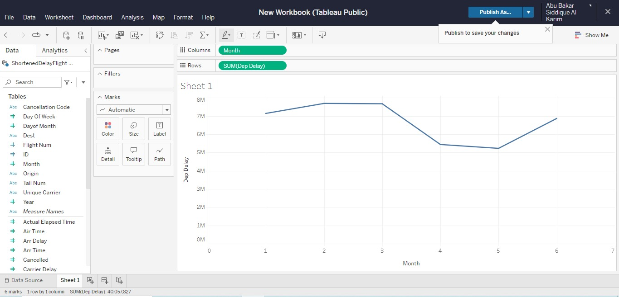
Visualization - DepDelay
We have tried to visualize the data using tableau and chose the Depdelay column to visualize, tried various combination to explain the departure delay and some of the other columns to get some sense of the data of the Depdelay column.
As the data is a time series data, considering Month as one variable to see at in which period, flights had been delayed the most.
1 <- Jan, 2 <- Feb, 3 <- Mar, 4 <- Apr,
5 <-Jun, 6 <- July.

Slide 43
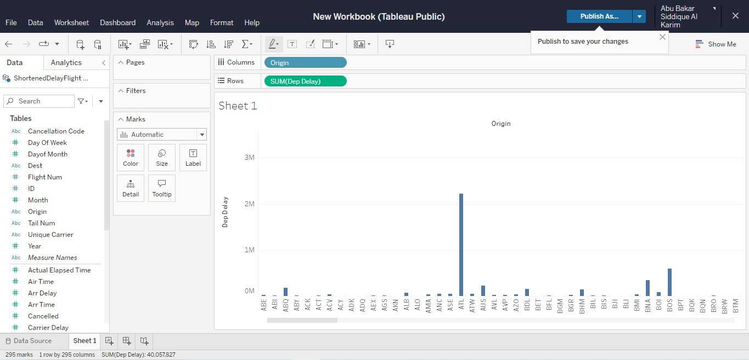
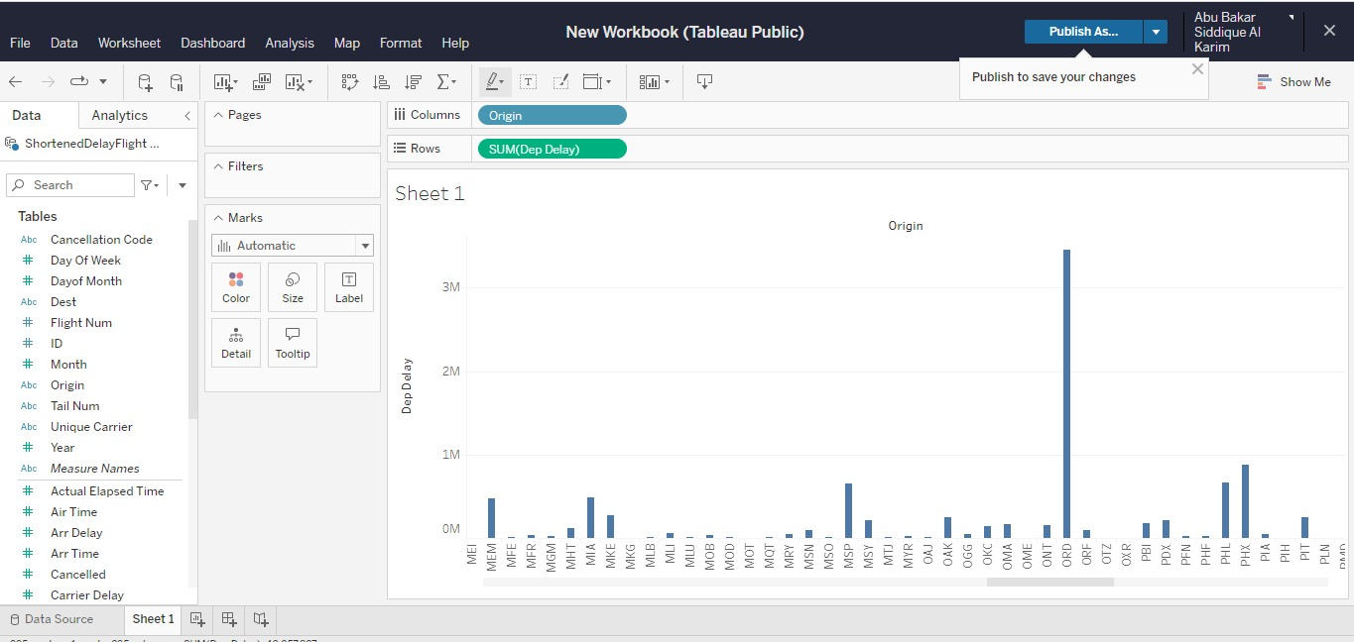
Visualization - DepDelay
Here we can see that in ORD has the highest frequency. That means flight that origins from ORD is delaying often. ATL has the second frequency in that observation.
ORD : Chicago O'Hare International Airport in Chicago, Illinois, USA.
ATL : Hartsfield-Jackson Atlanta International Airport, Georgia, USA.

Slide 44
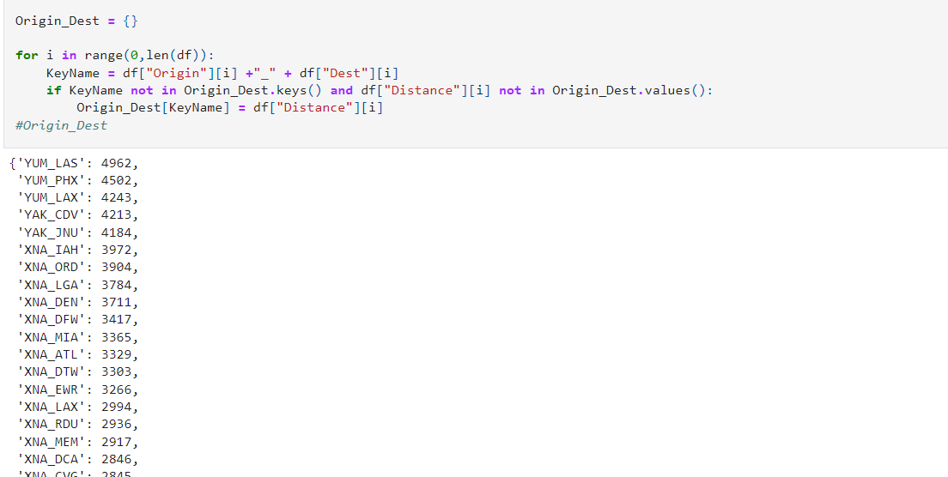
Visualization - Destination
Here we can see by using dictionaries, we have classified the flights pairing with the origin of departure and destination of arrival in the format of "org_dest : distance ".
Keys of the dictionary = org_dest
Values of the dictionary = distance
Thus, getting a rough idea of highest destination arrivals by a flight in the given time span.

Slide 45
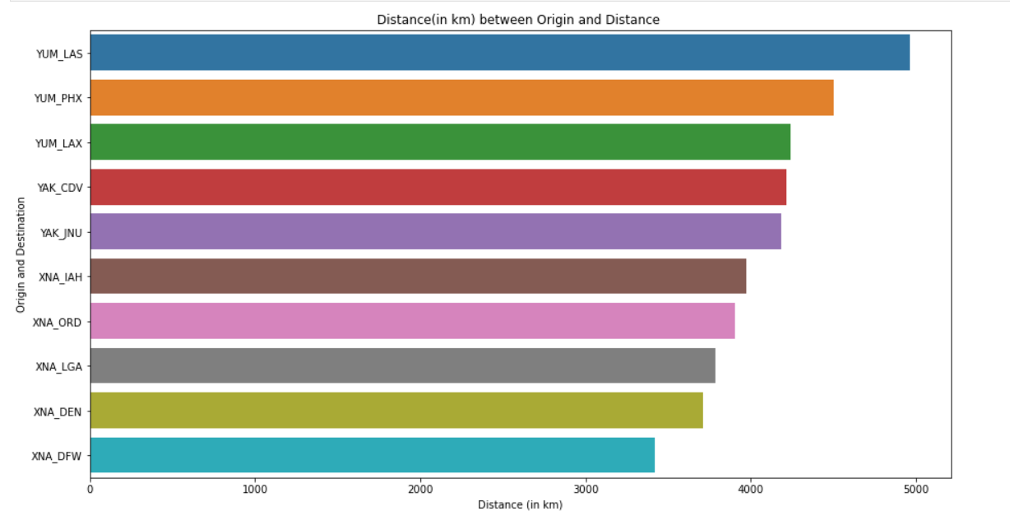
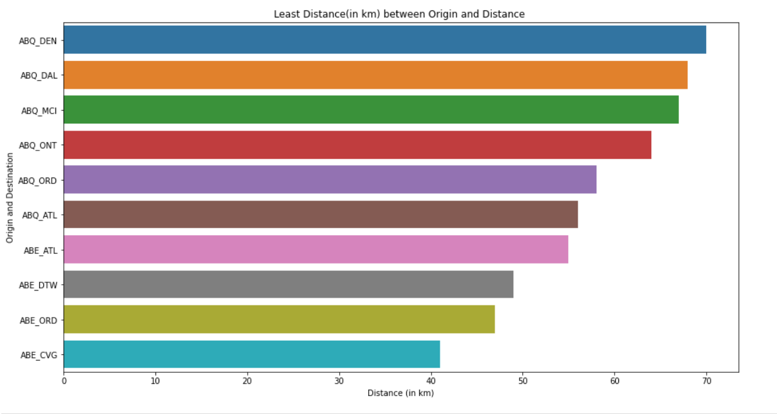
Visualization - Destination
Graphical representation of the pairing with respect to distance(in kilometers).

Slide 46
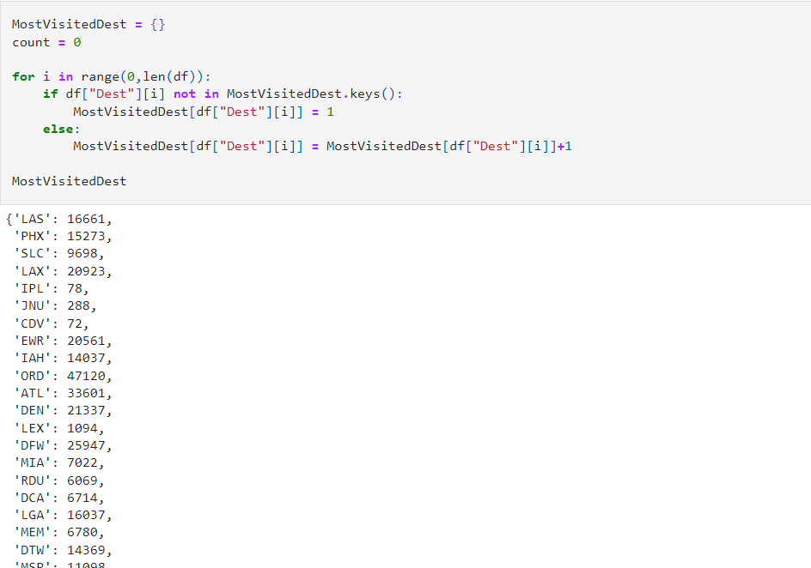
Visualization - Destination
Here we can see after the pairing, we created another dictionary stating the frequency of destination in the whole data set.

Slide 47
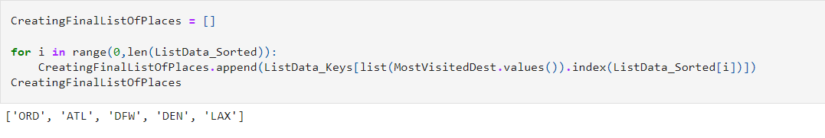
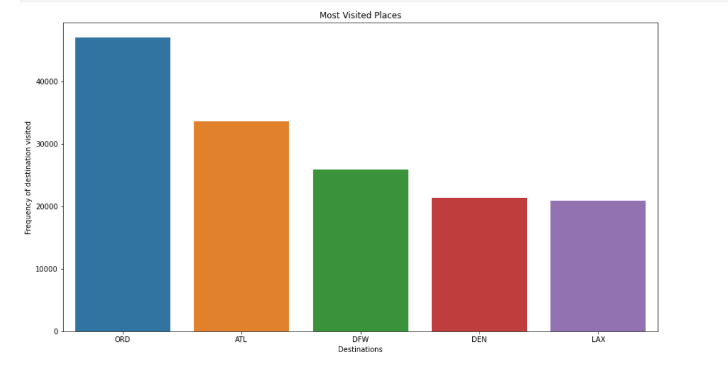
Visualization - Destination
Finally, we shortened the information of most visited places into top 5 places of destination which are:-
ORD: Chicago O'Hare International Airport in Chicago, Illinois, USA.
ATL : Hartsfield-Jackson Atlanta International Airport, Atlanta, Georgia, USA.
DFW: Dallas/Fort Worth International Airport, USA
DEN: Denver International Airport, Colorado, USA.
LAX: Los Angeles International Airport, Los Angeles, USA.

Slide 48
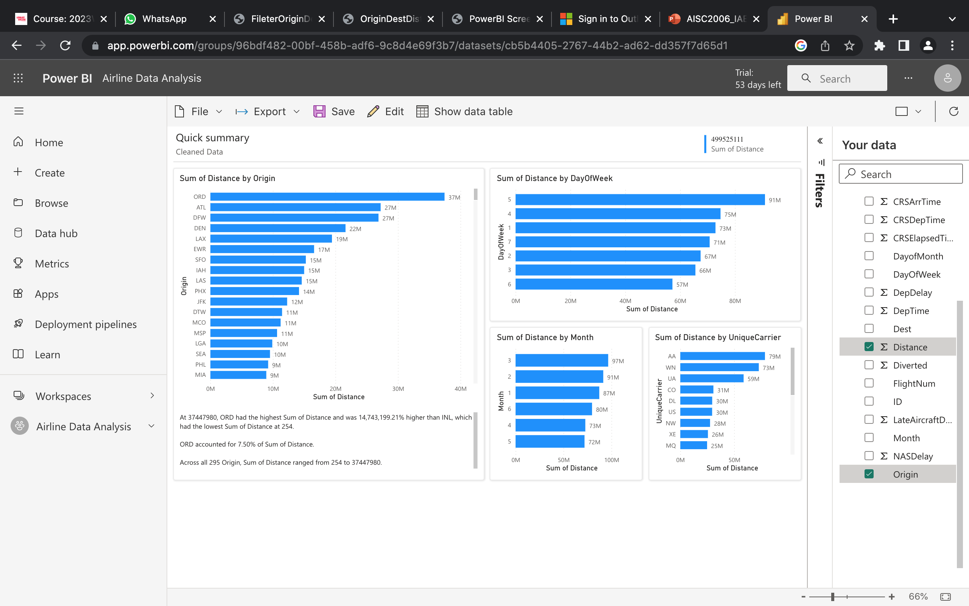
Visualization - Distance by Origin
The visualization shown on the right is done using Power BI tool, and the insights can be seen at the bottom of the graph.

Slide 49
Visualization – Distance by Day, Week and UniqueCarrier
The visualization shown on the right is done using Power BI tool, here you can see that the attributes like origin and distance is chosen for visualization.
From the visualisation, sum of distances in more on 5th day of the week, hence this can be thought of that more flights fly on that day of the week as compared to the rest days in the week. And a similar analysis can be drawn from the sum of distance by month graph, that busiest month is the March as most travels are being held at that time.
In short, two conclusions can be drawn from this, first more flights fly on these time intervals hence distance is more, other being that farthest distance flights are flying in this time interval, hence distance travelled is more.

Slide 50
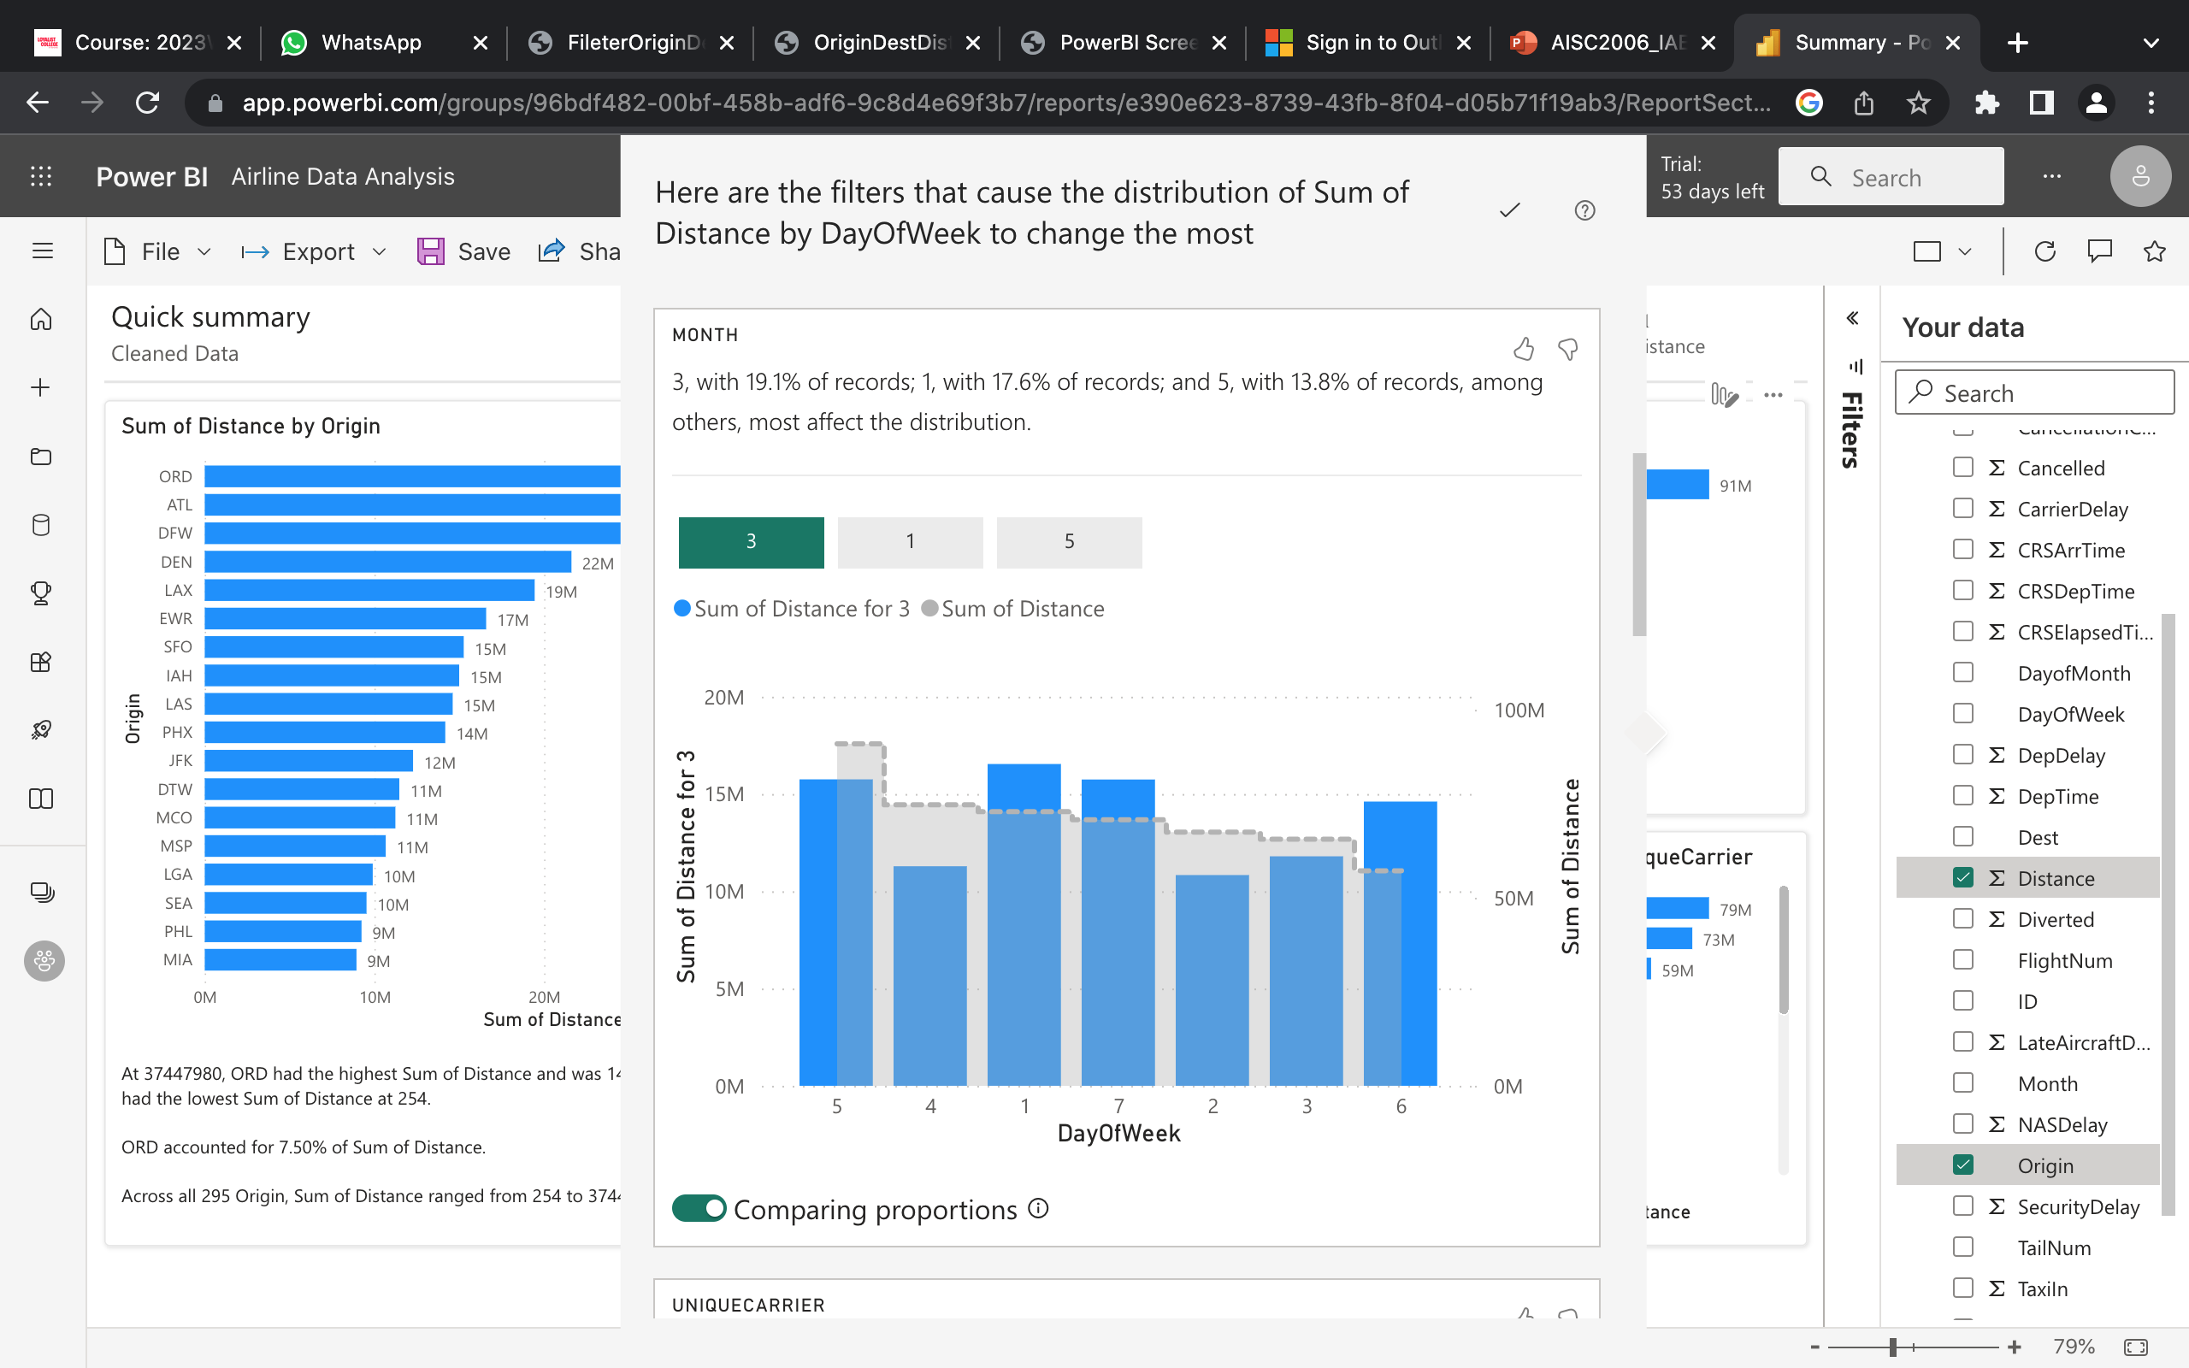
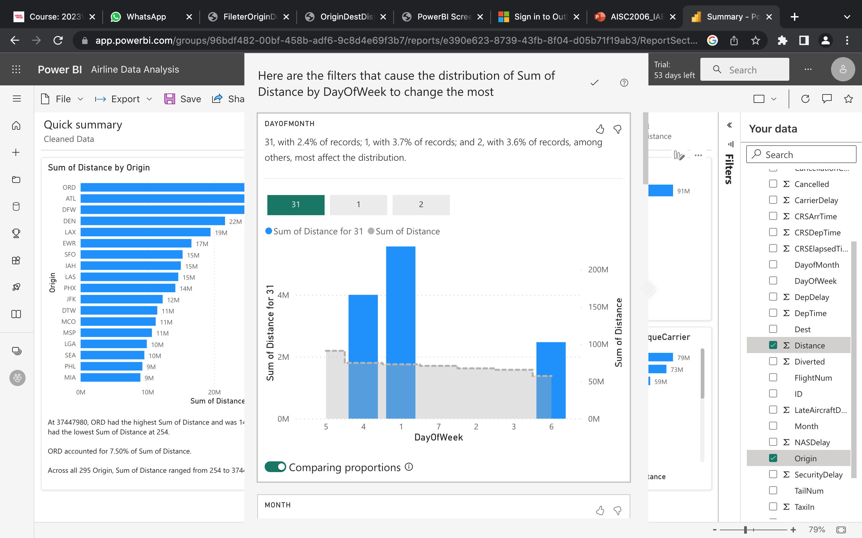
Visualization - Power BI Analysis

Slide 51
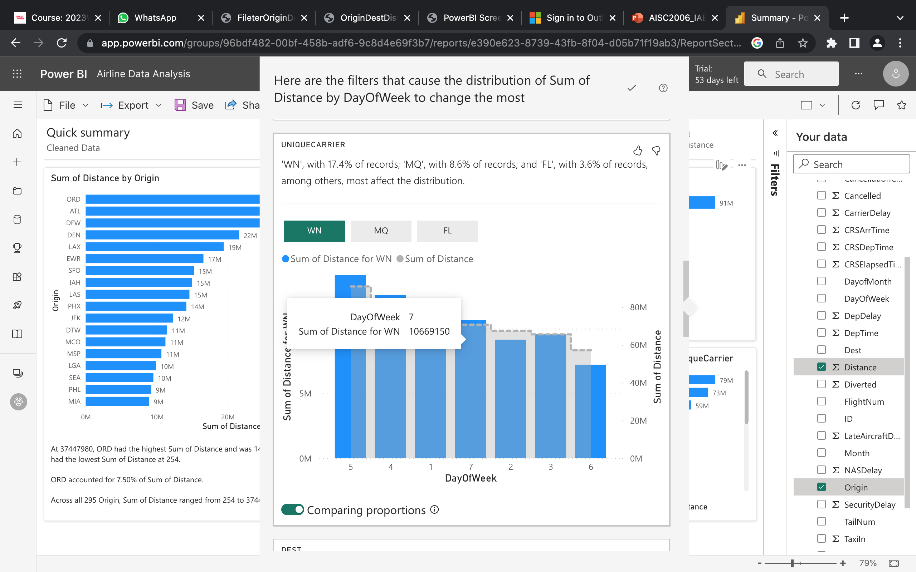
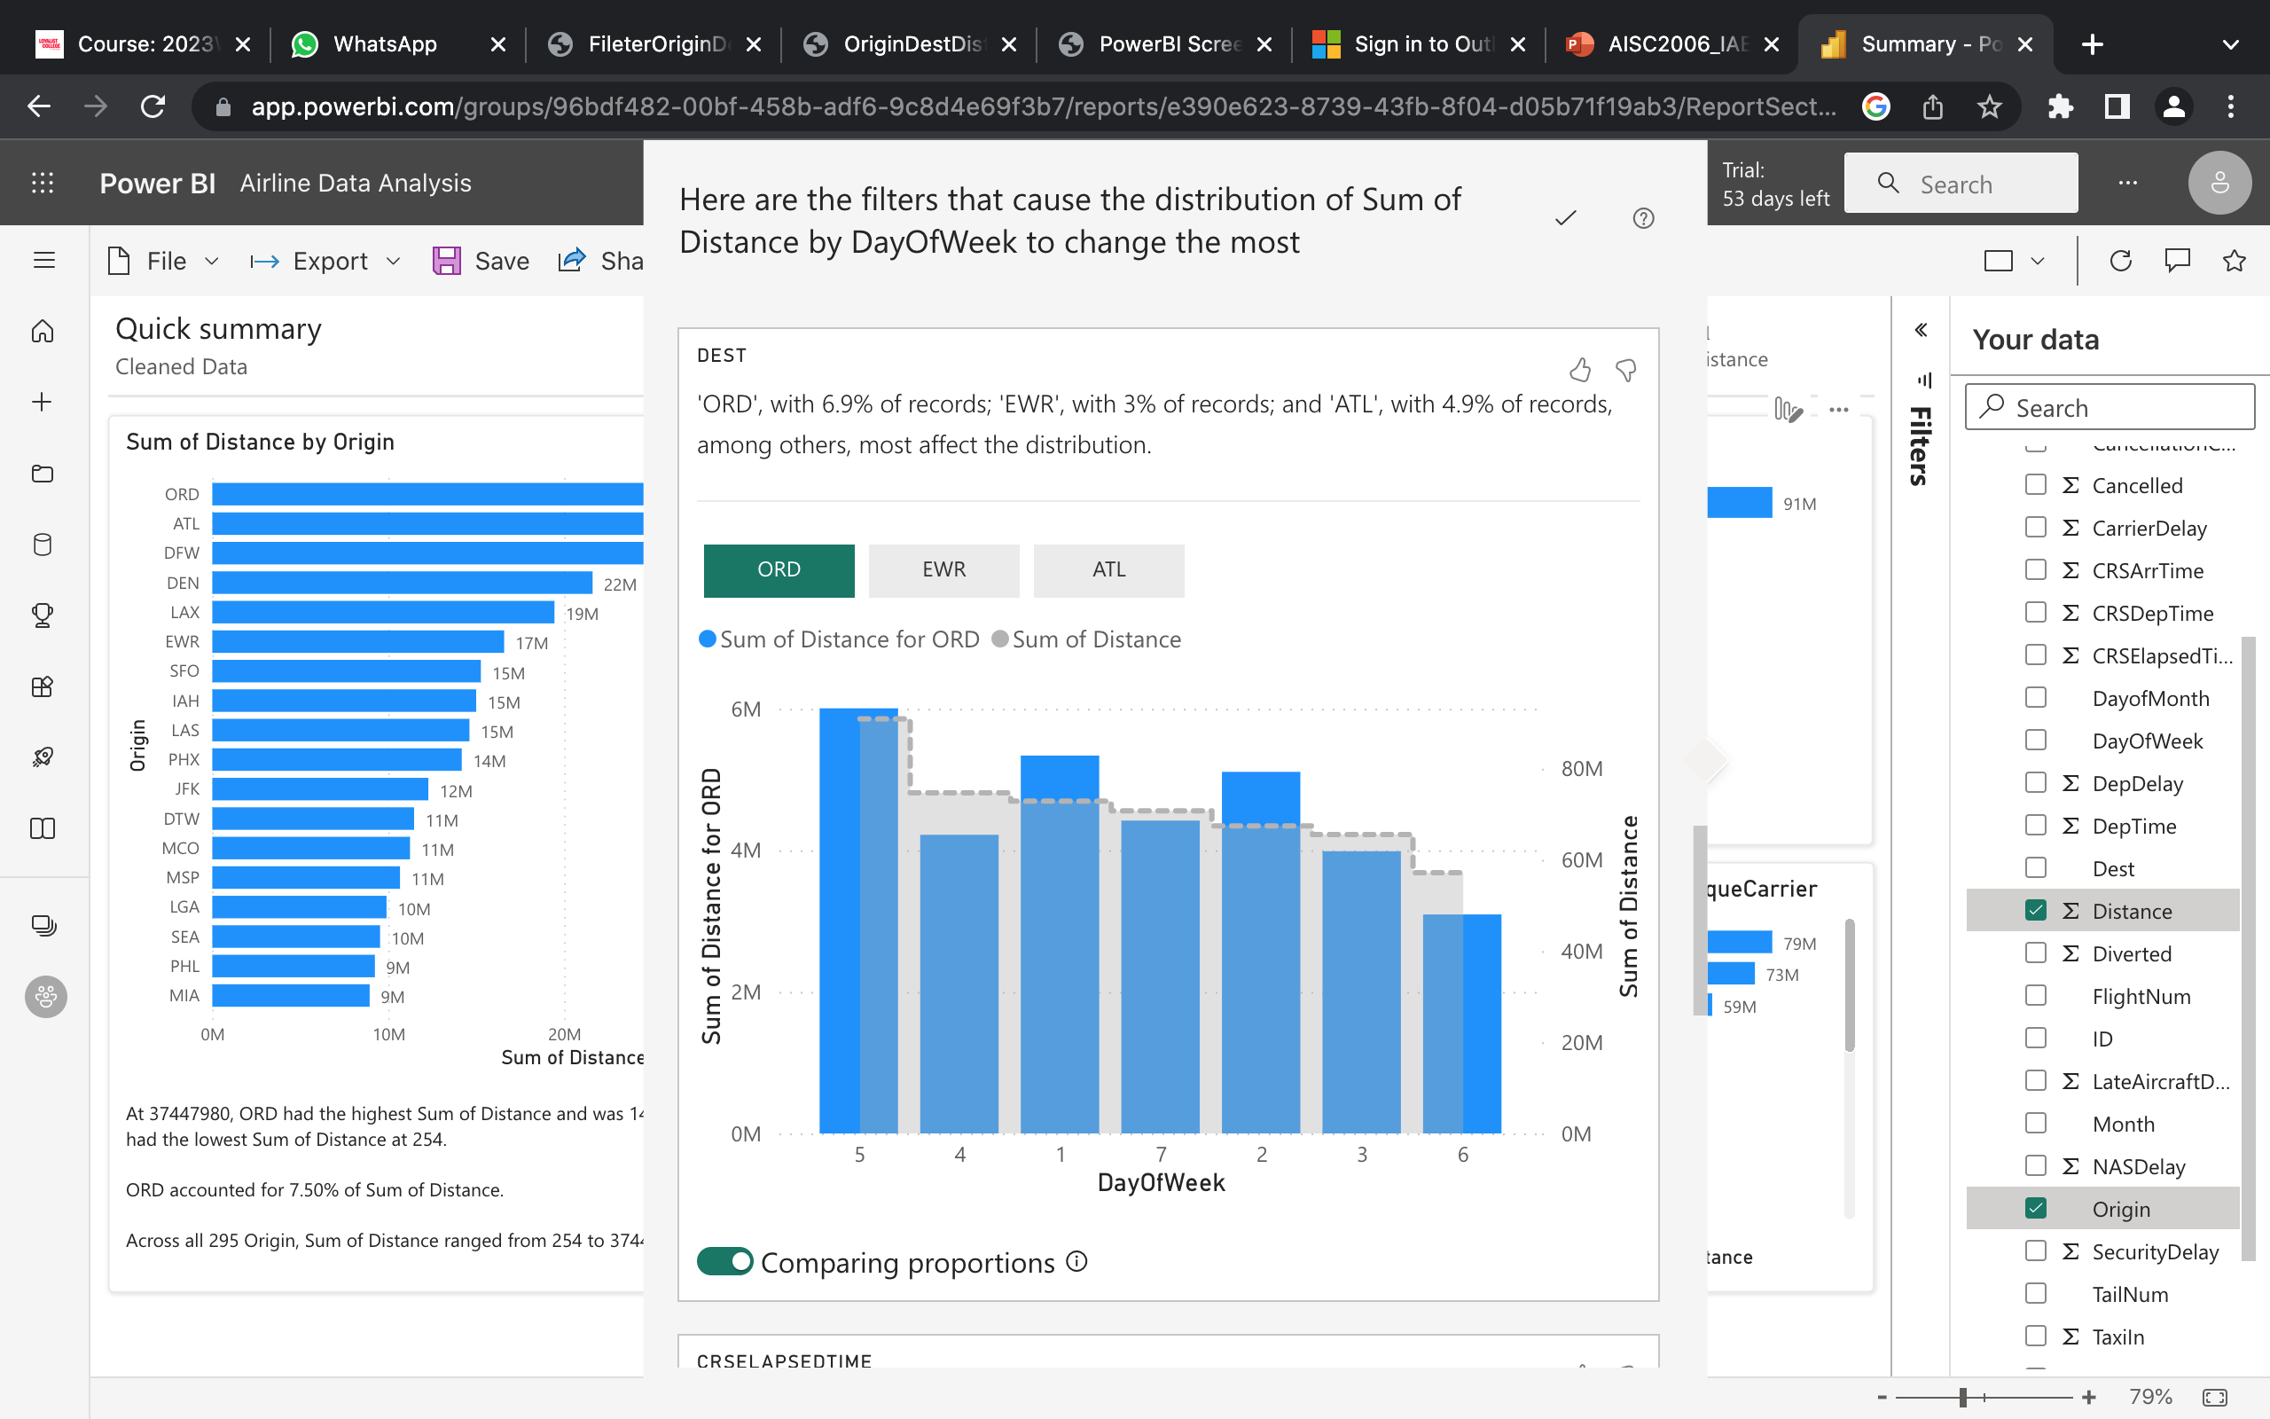
Visualization - Power BI Analysis

Slide 52
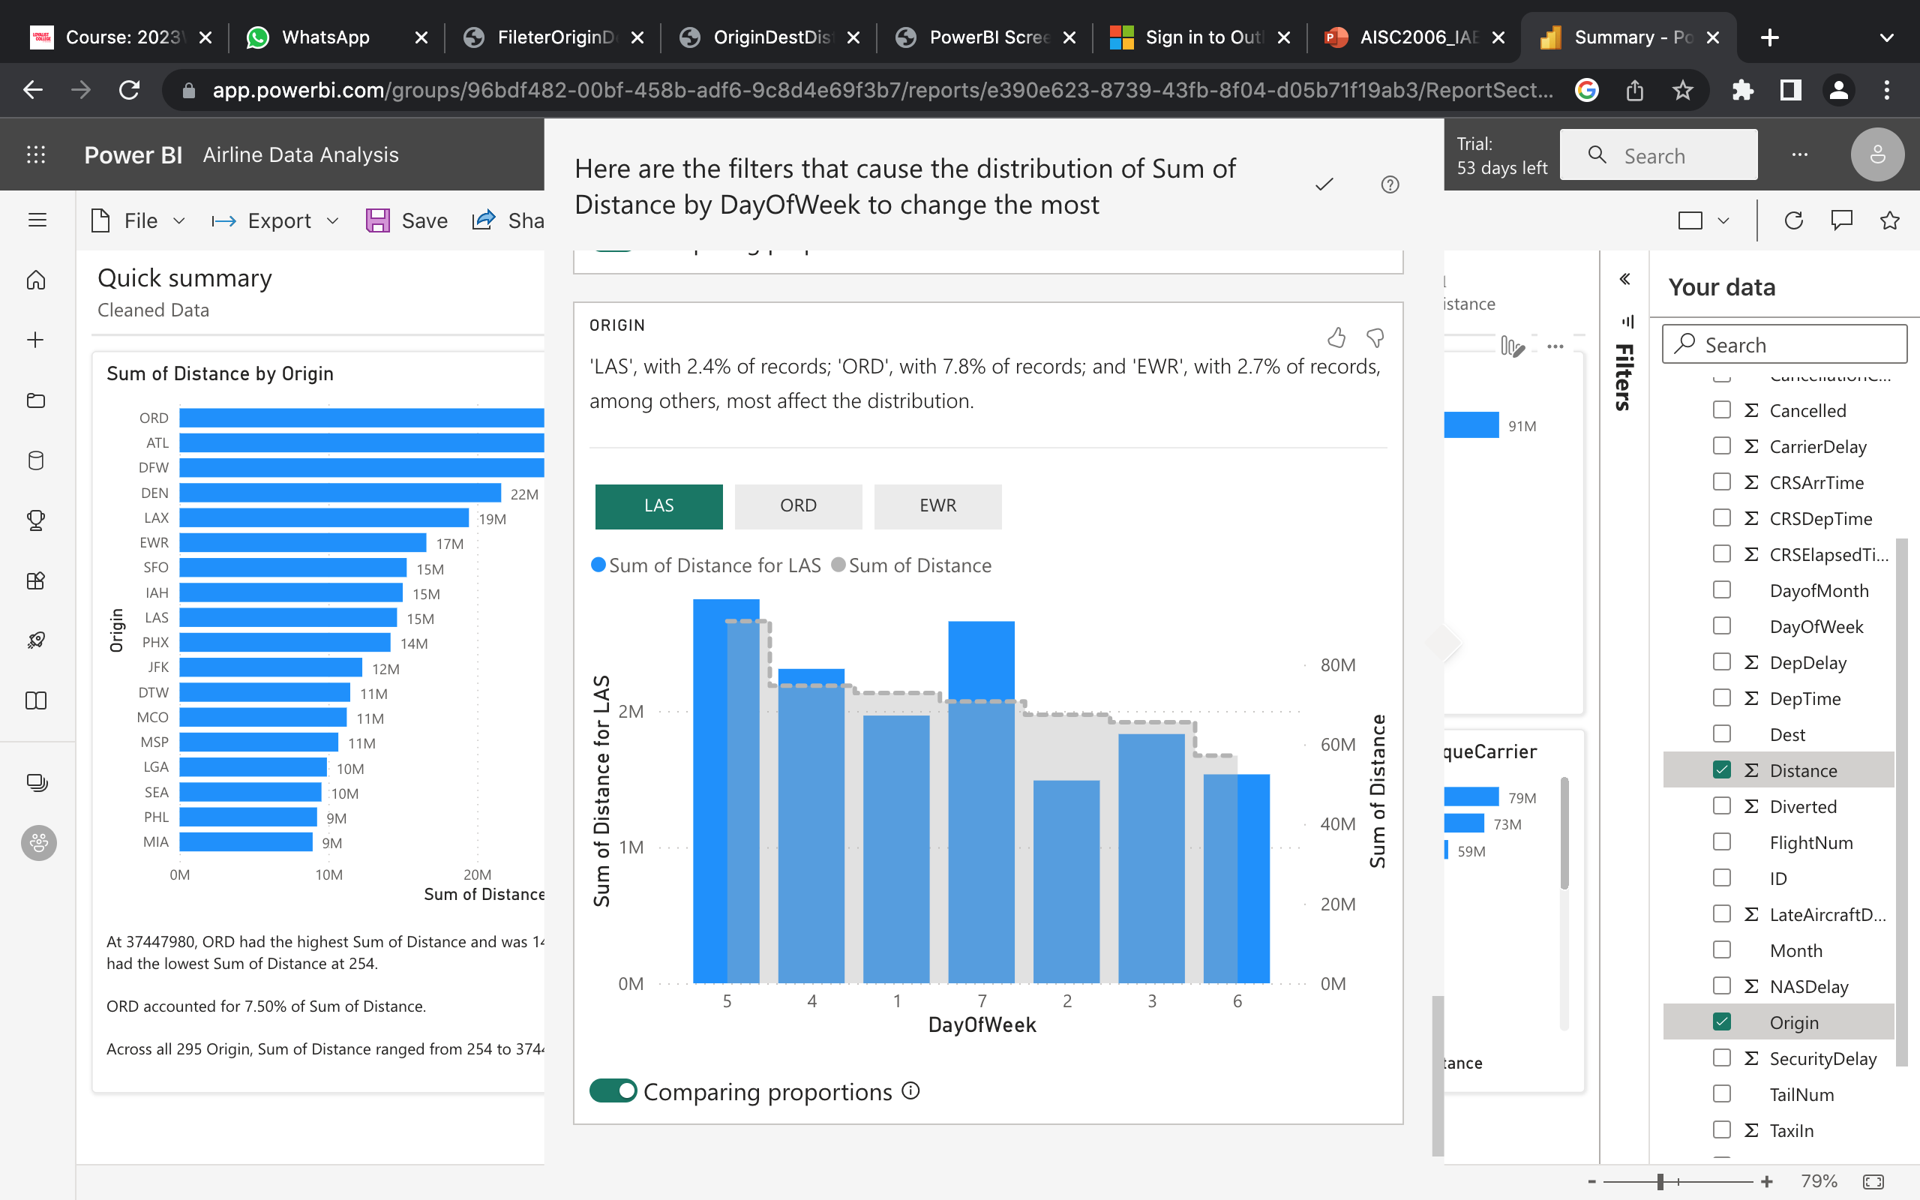
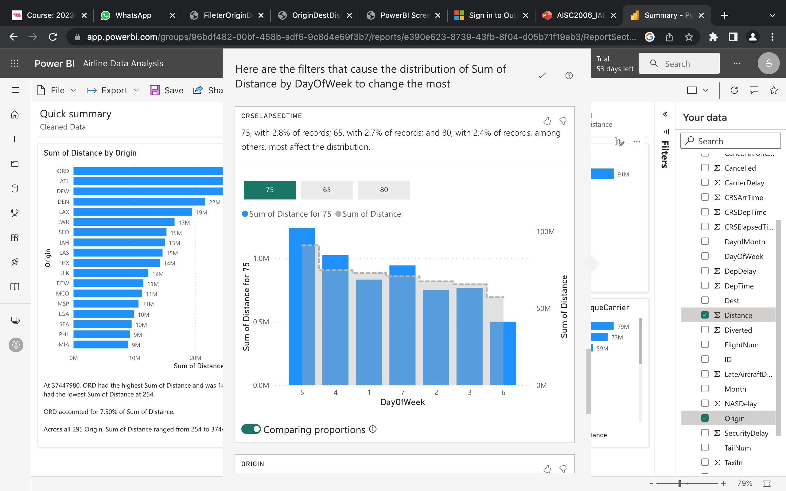
Visualization - Power BI Analysis​

Slide 53
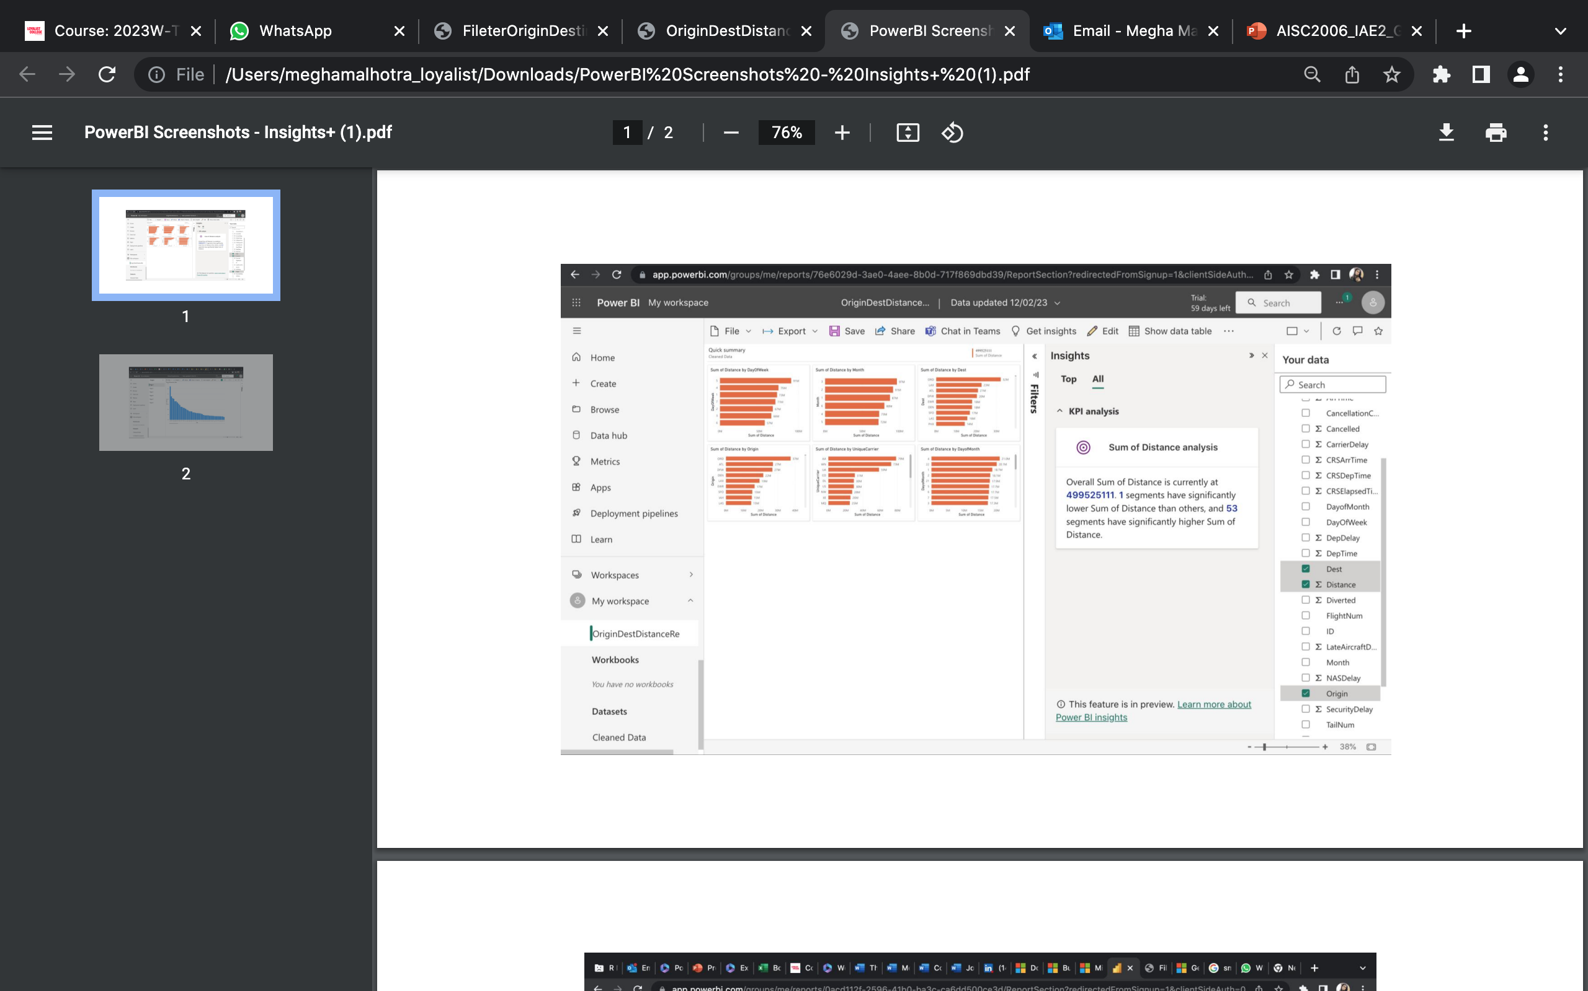
Power BI - Analysis

Slide 54
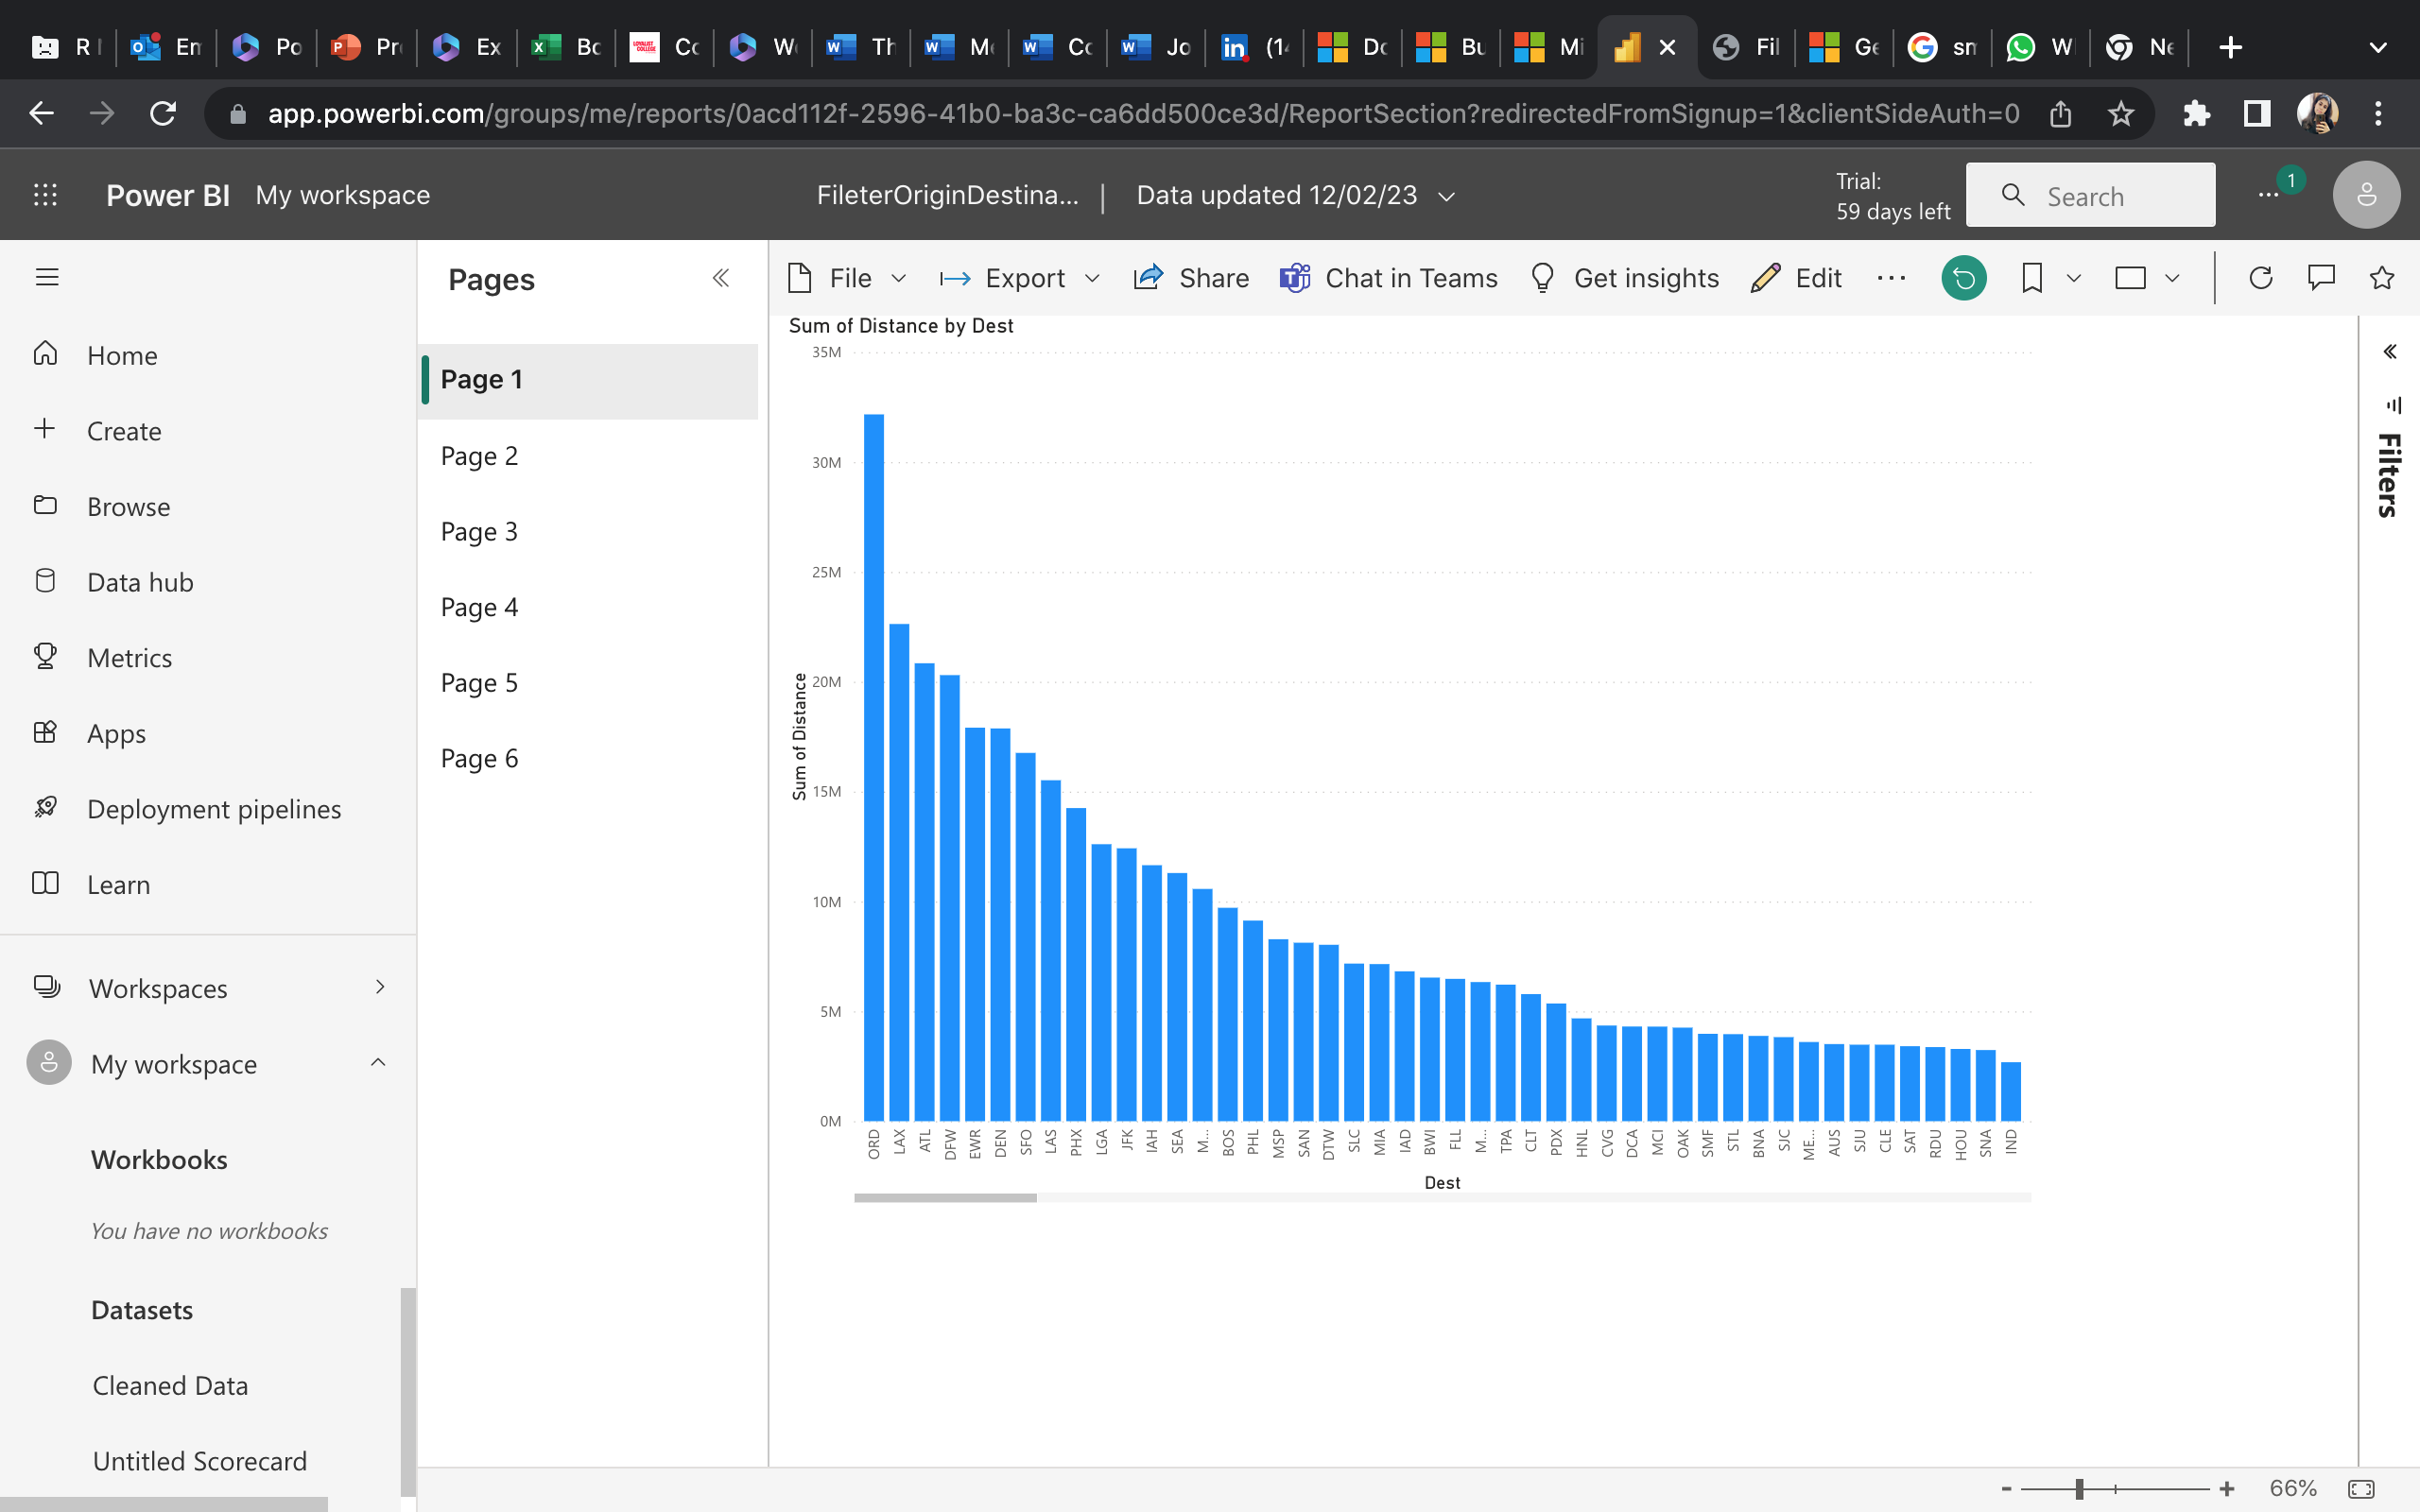
Generating reports using Power BI

Slide 55
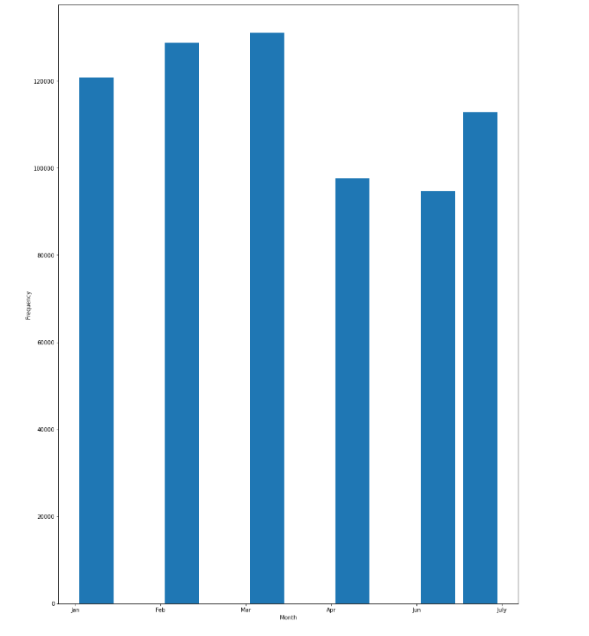
Visualization - Delays
Firstly, checking the frequency of flights occurred in the whole-time span.
March had the maximum number of flights as compared to other months

Slide 56
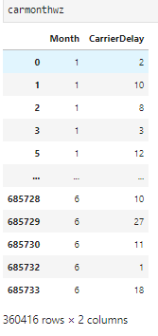
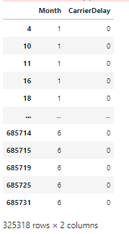
Visualization - delays – carrier delay
Here we can see that by using month as a measure of frequency.
Total number of flights having carrier delay = 360416
Total number of flight with no carrier delay = 325318

Slide 57
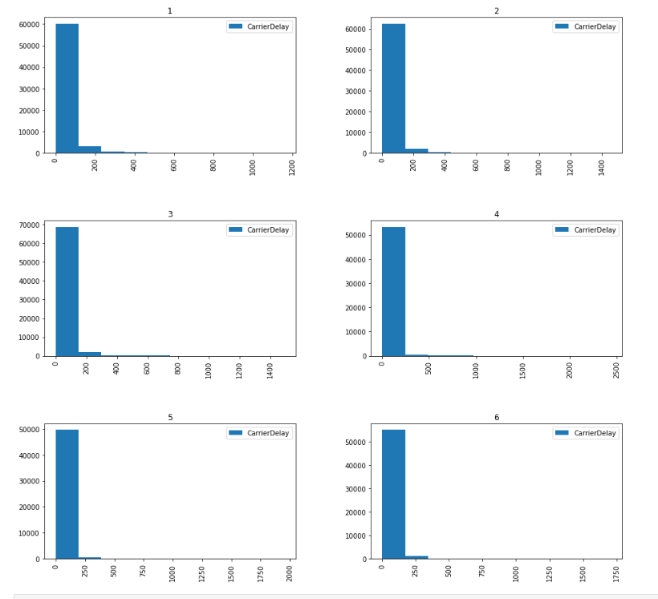
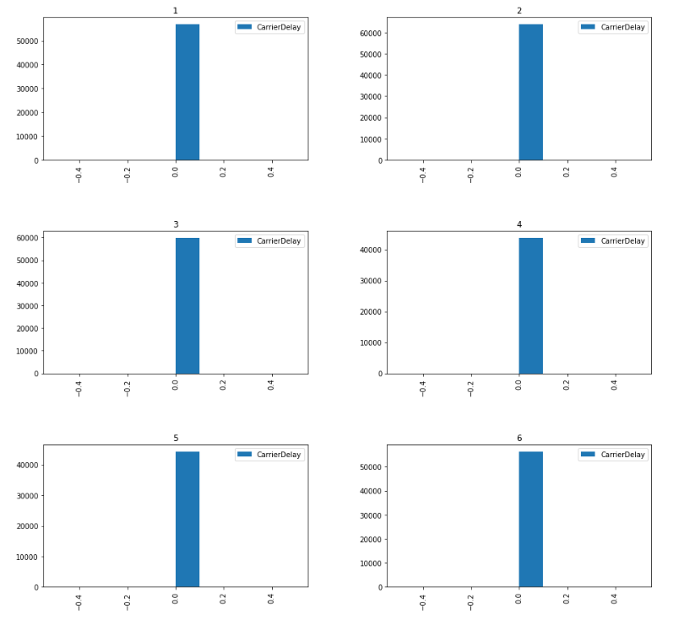
Visualization - delays – carrier delay
March had the greatest number of flights with carrier delay.
February had the greatest number of flights with no carrier delay

Slide 58
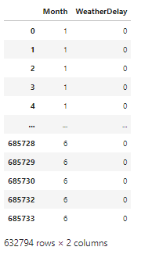
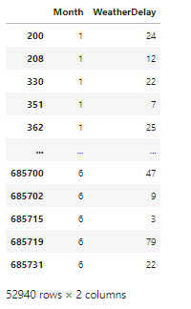
Visualization - delays – Weather delay
Here we can see that by using month as a measure of frequency.
Total number of flights having Weather delay = 52940
Total number of flight with no Weather delay = 632794

Slide 59
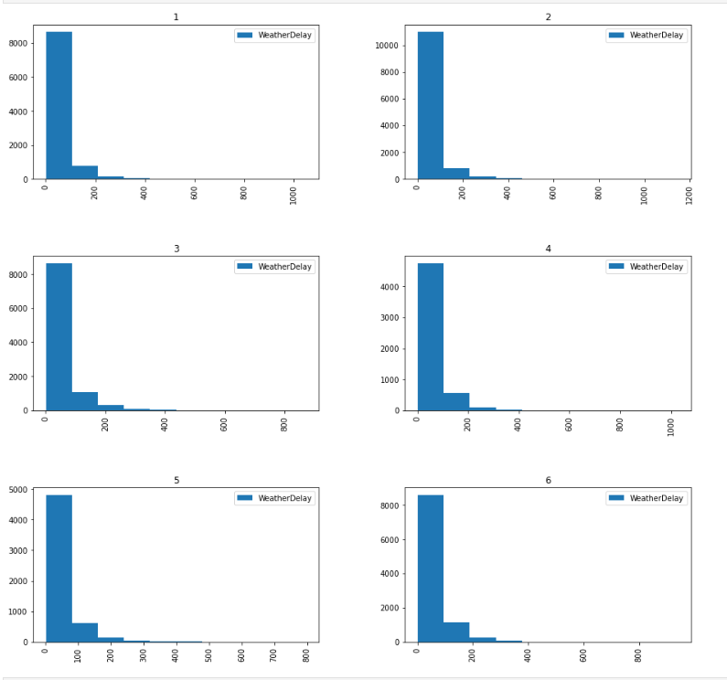
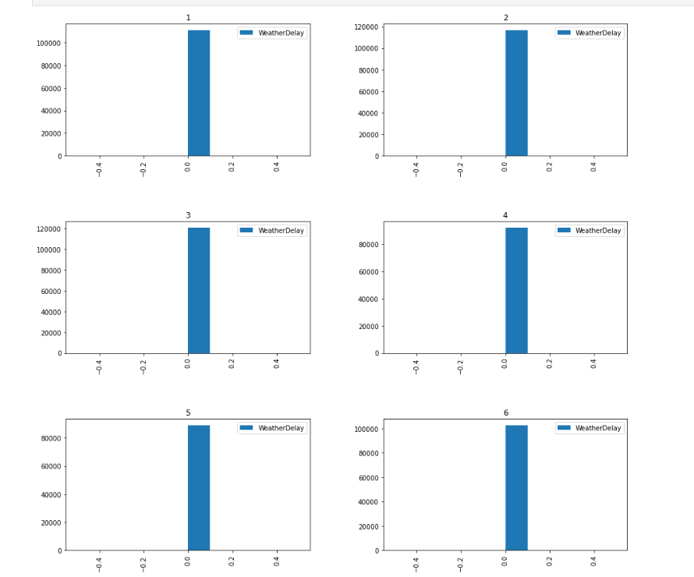
Visualization - delays – Weather delay
February had the greatest number of flights with Weather delay.
Feb and Mar had the greatest number of flights with no Weather delay

Slide 60
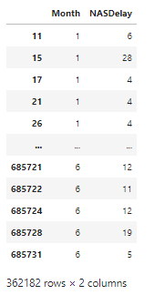
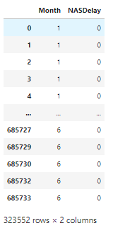
Visualization - delays – NAS delay
Here we can see that by using month as a measure of frequency.
Total number of flights having NAS delay = 362182
Total number of flight with no NAS delay = 323552

Slide 61
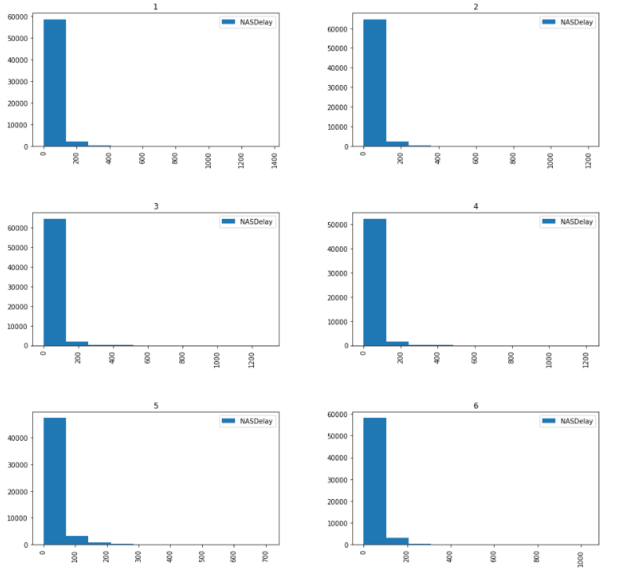
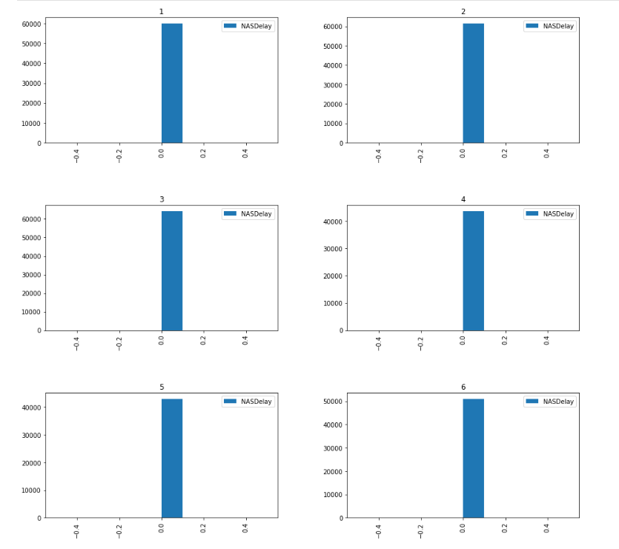
Visualization - delays – NAS delay
Feb and Mar month had the greatest number of flights with NAS delay.
March had the greatest number of flights with no NAS delay

Slide 62
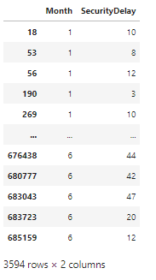

Visualization - delays – Security delay
Here we can see that by using month as a measure of frequency.
Total number of flights having Security delay = 3594
Total number of flight with no Security delay = 682140

Slide 63


Visualization - delays – Security delay
Here we can see that by using month as a measure of frequency.
March had the greatest number of flights with Security delay.
Jan, Feb and Mar had the greatest number of flights with no Security delay

Slide 64


Visualization - delays – Late Aircraft delay
Here we can see that by using month as a measure of frequency.
Total number of flights having late aircraft delay = 387642
Total number of flight with no late aircraft delay = 298092

Slide 65


Visualization - delays – Late aircraft delay
Here we can see that by using month as a measure of frequency.
Feb and March had the greatest number of flights with Late aircraft delay.
Jan, Feb and Mar had the greatest number of flights with no late aircraft delay
Thus, overall March was the month with majority of the delays, although March also had higher number of zero delayed flights as well, but it is because of flights occurred overall.

Slide 66

Visualization of Taxi-In Field
It shows the distribution of the TaxiIn field in the Airlines Delay dataset.
The distribution is representing the most common taxi-In time interval with respect to number of flights (frequency).

Slide 67

Visualization of Taxi-In Field
This scatter plot shows a rough distribution of the data of Taxi-In with respect to Arrival Delay.

Slide 68

Visualization of Taxi-In Field
There is a wide variation in TaxiIn times across carriers, with some carriers having significantly longer TaxiIn times than others.
The median TaxiIn time for most carriers is between 5 and 10 minutes, with a few carriers having median TaxiIn times of around 15 minutes.
The interquartile range (IQR) of TaxiIn times varies across carriers, with some carriers having a narrow IQR and others having a wide IQR.

Slide 69

Visualization of Taxi-Out Field
The majority of flights have a TaxiOut time between 0 and 20 minutes, with a peak around 10 minutes.
This suggests that there are factors that are causing a delay in the process of getting the planes from the gates to the runway.
The long tail on the right side of the histogram indicates that there are a small number of flights with very long TaxiOut times, which could be due to a variety of factors such as airport congestion, weather conditions, or maintenance issues.

Slide 70

Visualization of Taxi-Out Field
Similarly, to previous scatter plot, this one shows a rough distribution of the Taxi-Out data with respect to Arrival Delay.

Slide 71

Visualization of Taxi–out Field
By looking at the box plot, we can see that there is some variation in Taxi-Out times between carriers, with some having a wider distribution than others. However, there are no carriers that stand out as having consistently higher or lower Taxi-Out times than the others.

Slide 72

Visualization of ArrDelay Field
Some carriers have a larger proportion of flights with significant ArrDelay values than others. This could suggest that these carriers have operational challenges or issues that lead to more delays. Simultaneously carrier with low Arrdelay signifies efficiency of operations and better scheduling.

Slide 73



ArrDelay vs Dest.
The 3 destinations that were found to have the highest arrival delays are ATL, EWR and ORD.
ORD : Chicago O'Hare International Airport in Chicago, Illinois, USA.
ATL : Hartsfield-Jackson Atlanta International Airport, Georgia, USA.
EWR : Newark Liberty International Airport, New Jersey, USA.

Slide 74
Summary of visualization
By reviewing the information gathered by visualizing the data, several pattern we have noticed are:-
March had the maximum number of delays which can be seen by the graph of Departure delay and others as it was the month in which commuters travelled the most.
Chicago was the most preferable destination among the travellers in 2008, however Chicago had the greatest frequency of delay of departure of the flight.
Security delay was the rarest delay occurred in the whole period, with only occurring in 3.5k flights.
More number of flights departed from Yuma a city of Arizona and arrived at Paradise a city of Nevada around 5000 times which is way more as compared to other combinations of origin and destination.
Distance based visualization tells that most distances are being travelled on 5th day of the week and the busiest month is March.
American Airlines, Inc's carriers had travelled the maximum total distance.
In short, two conclusions can be drawn from this, first more flights fly on these time intervals hence distance is more, other being that farthest distance flights are flying in this time interval, hence distance travelled is more.
Taxi-In median laid around 5-10 minutes, whereas Taxi-Out median laid around 10-15 minutes.
Flights to Chicago had the greatest frequency of delay of arrival, followed by Atlanta, Georgia.
Southwest Airlines had the highest arrival delays.

Slide 75
Data Story telling

Slide 76
Matrix of Duties - Story Telling
Data Storytelling has been done with respect to the columns visualized by each member: -
Abu Bakar – Storytelling with respect to DepDelay
Vidhut Sharma - Storytelling with respect to Destination
Megha Malhotra - Storytelling with respect to Distance
Parul Mehndiratta - Storytelling with respect to ArrDelay
Meeraben - Storytelling with respect to TaxiIn
Kamini - Storytelling with respect to TaxiOut
Janit Jindal - Storytelling with respect to overall data

Slide 77
Pert Chart- Story telling
Task Name | Week 9 | Week 10 | Week 11
Choosing Columns
Requirement Gathering
Creating Dashboards and understanding Tableau
Data Storytelling
Compiling work and summarize
Presentation Completion

Slide 78
Story Telling Steps
Start with selected columns
Story Telling
Summarize

Slide 79
What is Tableau?
Tableau is a powerful data visualization and business intelligence tool that provides users accessibility to analyse and display data in a user-friendly, interactive way.
It provides a range of tools and features for data preparation, exploration, analysis, and visualization.
Tableau connects to various data sources including spreadsheets, databases, cloud services, and big data platforms.
Users can create custom dashboards, reports, and visualizations using drag-and-drop interfaces and a range of chart types, tables, maps, and other visualization elements.

Slide 80

Origin and Destination
The dashboard built based on origin and destination features are connected to each other.
As we can observe from the graph on the right depicts multiple graphs which are with origin and destination with respect to distance.
When we selected a single bar from the graph titled as "Sum of distance with respect to Destination" automatically the graph titled as "Sum of distance with respect to Month" changes and provides us the months from increasing to decreasing order in which distance is covered.

Slide 81

Departure Delay
This Dashboard is particularly built on Departure Delay, As we can see there are multiple graphs of Departure Delay with respect to Month and origin of departure
When we selected a single bar from the graph "Frequency of Flights in Months" we can see the filtering in the other graphs too showing the specific month and info about ORD (maximum arrival dep origin).

Slide 82

Delays
This Dashboard is particularly built on the different delays occurring namely Late Aircraft delay, NAS delay, Carrier delay, Security delay, Weather delay with respect to Months.
These graphs includes only those flights which do not have the mentioned delays.
When use the tool on the top right corner, we can enter which month we want to be highlighted.

Slide 83

Delays
For example, by enter 3 as 3rd Month we can see it has highlighted the 3rd month bar in all the graphs.

Slide 84

Delays
As like earlier dashboard, this one excludes the flights with 0 delays of any kind

Slide 85

Arrival Delay
This Dashboard is particularly built on Arrival Delay, As we can see there are multiple graphs of Arrival Delay with respect to Month and unique carrier.

Slide 86

Dashboard for Taxi-in Field
The picture you see on the right side is a dashboard of taxi-in field
As you can see on the treemap graph, WN has a longer taxing time as compared to others.
Talking about the bar chart, most of the destinations has a shorter period of taxiing time.
So, overall looking at the dashboard, we can see that taxi-in field does not impact on the delay.

Slide 87

Dashboard of Taxi-out Field
The picture you see on the right side is a dashboard of taxi-out field
As you can see on the treemap graph, ORD has a longer taxing time as compared to others.
Talking about the bar chart, most of the destinations has a average period of taxiing time.
So, overall looking at the dashboard, we can see that taxi-out field does not impact on the delay.

Slide 88

Distance
The dashboard on the right is build taking distance as the base.
5 features are being depicted in the dashboard where the distance travelled is being observed.
As the origin and destinations are more in number and all of them can't be displayed together, hence, the scroll bar is being used.
The distance covered by various unique carrier can be observed. Also, the distance travelled in that month along with day of month can also be seen simultaneously using the dashboard.

Slide 89
Links of Tableau
https://public.tableau.com/app/profile/janit.jindal/viz/AirCraftDelaysDataSet/DEPARTUREDELAYDASHBOARD
https://public.tableau.com/app/profile/vidhut.sharma/viz/AircraftDelayOrigin_Destination/OrigiinandDestinationCombinationswithrespecttoDistance?publish=yes

Slide 90
Thank You!

Slide 91
Data Modelling

Slide 92
Goal of Modelling
As we know, we have different kinds of delays occurring along with the taxi-in and taxi-out time, by considering them as independent variables we can predict whether the flight should be/will be cancelled or not.
Side-Goal: Comparing the models using performance matrix, ROC curves and accuracy.

Slide 93
Matrix of Duties - Modelling
Overall, we have selected 3 modelling techniques to pursue our goal: -
Bayes Theorem: - Vidhut Sharma & Parul Mehndiratta
Logistic Regression: - Abu Bakar & Megha Malhotra
Random Forest Classifier: - Janit Jindal, Meeraben & Kamini
Benchmarks:
Split of the Data = 70-30%
Randomness / random_state = 42
1 -> Flights Cancelled , 0-> Flights Not Cancelled

Slide 94
Pert Chart- modelling
Task Name | Week 12 | Week 13 | Week 14
Choosing Models
Requirement Gathering
Data Modelling
Compiling work and summarize
Presentation Completion

Slide 95
Modelling Steps
Choosing Models
Coding
Summarize

Slide 96
Bayes Theorem
We will be understanding Naïve Bayes with a mathematical example which will help us in model building as well.
We have some set of features for some fruits which are in dictionary format.
Fruits = {Yellow, Sweet, long}
The formula for Naïve Bayes Algorithm is as follows:
P(A|B) = P(B|A) * P(A) / P(B)
The Naïve Bayes algorithm used for building ML model is derived from this above equation.
We will be taking a basic calculative example to understand the same:
P(Yellow | Orange) = P(Orange | Yellow) * P(Yellow)/P(Orange)
= (350/800) * (800/1200) =(650/1200) = 0.5
Now like this we can check the probability of Orange w.r.t Sweer which is 0.69 and w.r.t Long is 0.
Now we can check if Orange is the fruit which satisfies all our features present in dictionary. For this we will multiply all the probabilities which we have calculated with respect to Orange which are 0.5 * 0.69 * 0 = 0.
Now we can check if Banana is the fruit which satisfies all our features present in dictionary. For this we will multiply all the probabilities which we have calculated with respect to Banana which are 1 * 0.75 * 0.87 = 0.65.
Now we can check if Others is the fruit which satisfies all our features present in dictionary. For this we will multiply all the probabilities which we have calculated with respect to Others which are 0.33 * 0.66 * 0.33 = 0.072.
Fruit | Yellow | Sweet | Long | Total
Orange | 350 | 450 | 0 | 650
Banana | 400 | 300 | 350 | 400
Others | 50 | 100 | 50 | 150
Total | 800 | 850 | 400 | 1200

Slide 97




Bayes Theorem
Imported libraries and read the data.
Dropping the non- essential columns and assigning the columns as features (X) and the target variable.
Splitting the data and fitting the data to achieve the accuracy score.

Slide 98





Bayes Theorem
Naïve Bayes when we trained the model, we observed that there was quite a less accuracy and more of recall.
The more recall is the good indication that our model is performing well.
When we talk about Precision, this shows us that the predictions made by the model is 50% like actual data.
This number is not that great as we are wrong in 50% of our predictions.

Slide 99
What is Logistic Regression
Logistic regression estimates the probability of an event occurring, such as voted or didn’t vote, based on a given dataset of independent variables. Since the outcome is a probability, the dependent variable is bounded between 0 and 1.

Slide 100



Logistic Regression
Imported libraries needed to be used and reading the data
Removing unnecessary data and splitting.

Slide 101

Logistic Regression
using LogisticRegression() to fit the model and predict accordingly

Slide 102


Logistic Regression
Then, printing a classification report for both training and testing data.

Slide 103
What is Random Forest
Random forest is a commonly-used machine learning algorithm trademarked by Leo Breiman and Adele Cutler, which combines the output of multiple decision trees to reach a single result. Its ease of use and flexibility have fueld its adoption, as it handles both classification and regression problems.

Slide 104



Random Forest
Importing important libraries of sklearn.
Splitting and classifying the X and Y variable into train and test.
Using make_classification as a boosting factor for the better accuracy.

Slide 105

Random Forest
Similarly, using our model and predict on test data.

Slide 106


Random Forest
After that, calculating the accuracy, performance matrix, f1 score and plotting a ROC curve for both train and test data.

Slide 107


Random Forest
ROC curves are almost similar because of similar accuracy and other factors.

Slide 108
Conclusion
Overall, by comparing the performance of all the three models, Random Forest Classifier seems to be the best model for our prediction with the accuracy of 88%. This model has a good accuracy, precision and recall as well making it a robust model from all aspects and its way of segregating data into subsets and building different subset trees makes it a good model which can be used for huge data sets as compared to other two models mentioned below.
Whereas the accuracy given by Logistic Regression is 50% as the data in our case is quite huge and Logistics does not perform that well on big data sets.
And with respect to accuracy given by Bayes Theorem is 50% this simply means that Naïve Bayes is not able to show difference between the categories and this model is not fit for huge data sets.

Slide 109
References
https://machinelearningmastery.com/metrics-evaluate-machine-learning-algorithms-python/
https://scikit-learn.org/stable/modules/generated/sklearn.metrics.accuracy_score.html
https://scikit-learn.org/stable/modules/generated/sklearn.ensemble.RandomForestClassifier.html
https://scikit-learn.org/stable/modules/generated/sklearn.model_selection.train_test_split.html
https://www.statology.org/plot-roc-curve-python/
https://scikit-learn.org/stable/modules/generated/sklearn.datasets.make_classification.html#:~:text=Generate%20a%20random%20n%2Dclass,of%20clusters%20to%20each%20class.
https://www.ibm.com/topics/random-forest
https://www.ibm.com/topics/logistic-regression

Slide 110
Thank You!

